Slide 1
A Reductionist view of Network Information Theory
Michael Langberg
SUNY Buffalo

Slide 2
Network Information Theory
The field of network communication is a very rich and intriguing field of study.
There has been great progress over the last decades, on several communication scenarios. Several problems remain open.
Studies may share at times analytical techniques, however, to some extent, each new problem engenders its own new theory.
Goal of unifying theory, that may explain the commonalities and differences between problems and solutions.
s₁
t₁
s₂
t₂
s₃
t₃
s₄
t₄

Slide 3
Towards a unifying theory
Individual studies focusing on specific problems have been extremely productive.
Different perspective: a “conditional” study of network communication problems.
Focus on connections: compare different comm. problems through the lens of reductions.
We can connect between problems without explicitly knowing either of their solutions.
s₁
t₁
s₁
t₁
s₂
N₁
t₂
s₂
N₂
t₂
s₃
t₃
s₃
t₃
s₄
t₄
s₄
t₄

Slide 4
Overview
Reductions.
Preliminaries: Network Coding.
Simplifying the NC model.
Is NC hard?
Reliable and Secure communication.
Can NC help solve other problems as well?

Slide 5
Reductions
Definition.
Example 1.
Example 2.
Example 3.

Slide 6
This talk: reductive studies
Index Coding/Network Coding.
Index Coding/Interference Alignment.
Multiple Unicast vs. Multiple Multicast NC.
Network Equivalence.
Secure Communication vs. MU NC.
Reliable Communication vs. MU NC.
2 Unicast vs. K Unicast NC.
Index Coding/Distributed storage.
…
Reductions can show that a problem is easy.
Reductions can show that a problem is hard.
Reductions allow propagation of proof techniques.
Study of reduction raise new questions.
Study of reductive arguments identify central problems.
Provides a framework for generating a taxonomy.
Have the potential to unify and steer future studies.
N₁
N₂

Slide 7
Noiseless networks: network coding
S₁
S₂
Directed network N.
Source vertices S.
Terminal vertices T.
Set of requirements:
  Transfer information from S_{i} to T_{j}.
Objective:
  Design information flow that satisfies requirements.
T₃
T₂
T₁

Slide 8
Communication
Each S_{i} transmits one of 2Rin messages.
S₁
T₁
S₂
T₂
R=(R₁,…R_{k}) feasible: for all ε>0 exist n: (ε,n)-feasible.
Capacity: closure of all feasible R.
S₃
T₃
S₄
T₄
Communication at rate R = (R₁,…,R_{k}) is achievable over instance (N,{(s_{i},t_{i})}_{i}) with block length n if: ∃ random variables {S_{i}},{X_{e}}:
Rate: Source S_{i} = R.V. independent and uniform with H(S_{i})=R_{i}n.
Edge capacity: For each edge e of cap. c_{e}: X_{e} = R.V. in [2^{cen}].
Functionality: for each edge e we have f_{e} = function from incoming R.V.’s X_{e1},…,X_{e,in(e)} to X_{e} (i.e., X_{e}=f_{e}(X_{e1},…,X_{e,in(e)})).
Decoding: for each terminal T_{i} we define
a decoding function yielding S_{i}.
  Communication is successful with probability 1-ε over {S_{i}}_{i}:
R=(R₁,…R_{k}) is ”(ε,n)-feasible” if comm. is achievable.
X₁
f_{e}
X₂
X_{e}
X₃
8

Slide 9
Examples
Example 1.
Example 2.

Slide 10
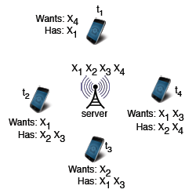
Index Coding [Birk,Bar-Yossef et al.]
IC is a special case of NC
  A set S of sources.
  A set T of terminals.
  Each terminal has some subset of sources (as side info.) and wants some subset of sources.
  Broadcast link has capacity c_{B}.
    Other links have unlimited cap.
Objective: To satisfy all terminals.
using broadcast rate c_{B}.
s₁
s₂
s₃
s₄
c_{B}
t₁
t₂
t₃
t₄

Slide 11
M-Multicat to M-Unicast
[Dougherty Zeger]
[Wong Langberg Effros]
[Kamath Tse Wang]

Slide 12
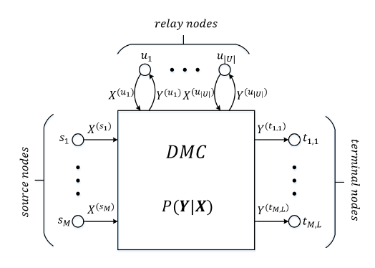
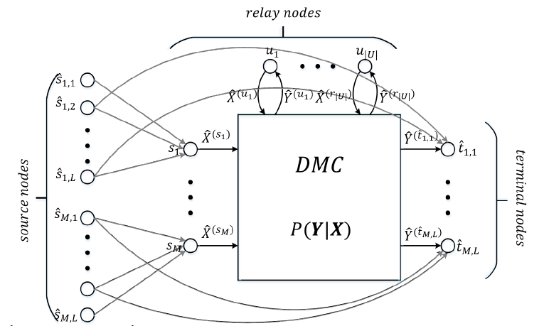
Multiple Unicast Index Coding
Third step: Reduce to Multiple Unicast
Network Coding [Dougherty Zeger].
Linear Index Coding [Maleki Cadambe Jafar].
General (noisy) networks including IC [Wong Langberg Effros].
[Langberg Effros]
Zero error
MU Index
Coding
NC
Index
Coding
MU Index
Coding

Slide 13
Simplifying topology
s₁
s₁
s₂
s₃
s₄
s₅
s₆
s₂
NC
IC
t₁
t₂
t₁
t₂
t₃
t₄
t₅
t₆
Theorem: For any NC, R one can construct IC, R’ such that for any n: NC is (R,n)-feasible iff IC is (R’,n)-feasible.
Step 1: Present reduction from NC to IC.
Step 2: Equivalence for linear and general encoding/decoding. [ElRouayhebSprintsonGeorghiades], [EffrosElRouayhebLangberg].

Slide 14
The reduction
NC sources
NC sources
NC edges
X₁
NC
Network:
edges
IC
X₂
X_{e}
X₃
NC terminals
NC term.
NC edges
Index Coding instance:
  Sources corresponding to NC sources, and NC edges.
  Terminals corresponding to NC term., NC edges, special terminal.
  For edge e: terminal t_{e} in IC wants IC source X_{e} and has as side information all IC sources incoming to e in NC.
IC encodes topology of NC in its terminals!

Slide 15
The reduction in more detail
NC sources
NC sources
NC edges
X₁
NC
Network:
edges
IC
X₂
t_{i}
X₃
NC terminals
NC term.
NC edges
Sources: |S|+|E| sources, one for each source of NC and one for each edge of NC: {S_{i}’} and {S_{e}’}.
Terminals: |T|+|E|+1 terminals:
  One terminal t_{i}’ for each t_{i}: wants S_{i}’ and has {S_{e}’} for e in In(t_{i}).
  t_{e}’ for each edge e: wants S_{e}’ and has {S_{a}’} for edge a in In(e).
  One special terminal t_{all}: wants {S_{e}’} and has {S_{i}’}.

Slide 16
The reduction in more detail
Reduction | NC | IC
Sources | S₁,…,S_{k} | {S_{i}’}, {S_{e}’}
Terminals | t₁,…,t_{k} | {t_{i}’},{t_{e}’},t_{all}
Capacities | c_{e} | c_{B}=∑c_{e}
Rate | R₁,…,R_{k} | {R_{i}’}, {R_{e}’} R_{i}’=R_{i} R_{e}’=c_{e}
NC edges
NC sources
NC sources
Network:
edges
NC terminals
NC term.
NC edges
Sources: |S|+|E| sources, one for each source of NC and one for each edge of NC: {S_{i}’} and {S_{e}’}.
Terminals: |T|+|E|+1 terminals:
  One for each terminal t_{i}: wants S_{i}’ and has {S_{e}’} for e in In(t_{i}).
  One for each edge e: wants S_{e}’ and has {S_{a}’} for edges a in In(e).
  One special terminal t_{all}: wants {S_{e}’} and has {S_{i}’}.
Bottle neck edge of capacity c_{B}=∑c_{e.}
Given rate vector R=(R₁,…,R_{k}) we construct rate vector R’=({R_{i}’};{R_{e}’}):
  R_{i}’=R_{i} and R_{e}’=c_{e}.
 | Has | Wants
t_{i}’ | {S_{e}’} for e in In(t_{i}). | S_{i}’
t_{e}’ | {S_{a}’} for a in In(e). | S_{e}’
t_{all} | {S_{i}’} | {S_{e}’}
X₁
Theorem: For any NC, R one can construct IC, R’ such that for any n: NC is (R,n)-feasible iff IC is (R’,n)-feasible.
X₂
t_{i}
X₃

Slide 17
Theorem
Reduction | NC | IC
Sources | S₁,…,S_{k} | {S_{i}’}, {S_{e}’}
Terminals | t₁,…,t_{k} | {t_{i}’},{t_{e}’},t_{all}
Capacities | c_{e} | c_{B}=∑c_{e}
Rate | R₁,…,R_{k} | {R_{i}’}, {R_{e}’} R_{i}’=R_{i} R_{e}’=c_{e}
NC sources
NC sources
NC edges
NC edges
NC terminals
NC term.
NC edges
s₁
s₁
s₂
s₃
s₄
s₅
s₆
 | Has | Wants
t_{i}’ | {S_{e}’} for e in In(t_{i}). | S_{i}’
t_{e}’ | {S_{a}’} for a in In(e). | S_{e}’
t_{all} | {S_{i}’} | {S_{e}’}
s₂
t₁
t₂
t₁
t₂
t₃
t₄
t₅
t₆
Theorem:
NC is (R,n)-feasible iff IC is (R’,n)-feasible.

Slide 18
Scalar Linear Coding
s₁
s₂
t₂
t₁
t₃
Q: Given an instance G with requirements R=[r_{ij}], can one determine if instance has scalar linear capacity of 1.
  Think of first capacity definition.
  Each source holds single character to be transmitted.
A: “No” [Lehman Lehman].
NP-hard to determine scalar linear feasibility (C=1).
  We are not even asking to find a network code!!
Proof Technique by reduction:
Show that solving the problem at hand efficiently will enable the efficient solution of a “hard” problem.
Instance to hard problem ⇒ Network Coding instance
Solution to hard problem ⇐ Solution to NC problem

Slide 19
Scalar Linear Coding
s₁
s₂
Proof Technique by reduction:
Show that solving the problem at hand will solve a problem considered to be hard.
t₁
t₃
t₂
Q: Given an instance G with requirements R=[r_{ij}], can one determine if instance is linearly feasible when each source holds single character to be transmitted.
  Think of first capacity definition and require capacity = 1.
A: “No” [Lehman Lehman].
NP-hard to determine feasibility.
  We are not even asking to find a network code!!
Reduction from the 3-SAT problem.
3-SAT: given 3-CNF formula, determine if satisfiable.
3-SAT is a classical NP-Complete problem.

Slide 20
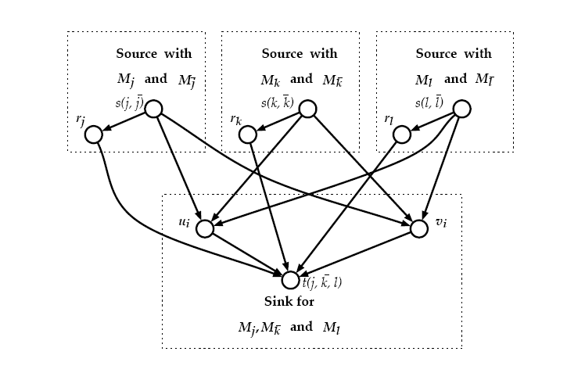
Scalar Linear Coding
Proof Technique by reduction:
Instance to hard problem ⇒ Network Coding instance
Solution to hard problem ⇐ Solution to NC problem
Given 3-SAT instance ϕ [Lehman Lehman] construct network coding instance (G,R) such that:
  Associate 2 sources with each variable corr. to TRUE and FALSE.
  Single terminal with each clause.
  With each clause associate a subgraph and terminal requirements.
  For
Reduction works: ϕ is satisfiable iff (G,R) is feasible.
[Lehman Lehman]

Slide 21
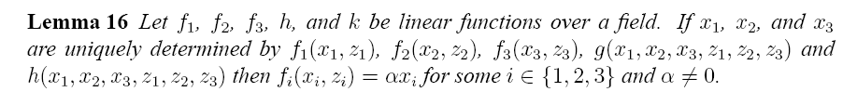
Scalar Linear Coding
Conclusion: NC instance feasible iff formula is satisfiable.
NP-hard to determine if instance is feasible (scalar linear).
Two sources for each variable.
For
Sink needs M_{j}, M_{k}, M_{l}.
Each pair of sources s_{j} needs to “pick” a TRUTH value and send it to r_{j}.
Sink gets “chosen” information of r_{j},r_{k},r_{l}.
Sink gets arbitrary source info. from u_{i} and v_{i}.
From u_{i} and v_{i} sink can get two out of the three.
Needs to get at least one from r’s.
_
[Lehman Lehman]
SAT⇒ feasible (easy).
Feasible ⇒ SAT (needs proof).
  For scalar linear mixing
[Lehman Lehman]

Slide 22
What about approximately finding capacity?
Up to now: Finding Scalar-Linear NC that obtains capacity is NP-hard.
Question: Is it easy to find a Scalar Linear NC that enables communication at rate 50% the capacity?
NO! “Hard” to find a Scalar Linear NC that enables communication within any constant factor of capacity.
Main idea: Use Index Coding and connection to the clique cover [LS].
  Previous two constructions do not extend when trying to find NC that approximately meet capacity.
0.001%

Slide 23
Secure NC

Slide 24
This work
Up to now: well understood!
Error correction in Network Coding.
  Objective: coding against jammer controlling links.
Look at simple open problem.
Single source, single terminal.
Acyclic networks.
All edges have unit capacities.
Adversary controls single link.
Some edges cannot be jammed.
What is the communication rate?
s
t

Slide 25
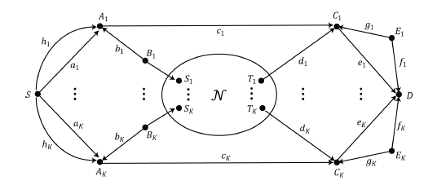
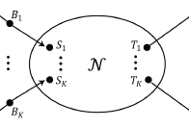
Related example
Determining secure capacity is as hard as determining the MU network coding capacity.
Similar setting was studied for wiretap adversaries [HuangHo LangbergKliewer; Chan Grant].
  Well understood: Multicast; uniform links; with single source generating randomness.
  Not well understood: Multiple nodes generate randomness.
Consider simple setting:
  Single source/terminal; acyclic; uniform edge cap.; 1 wiretaped edge; any node can generate randomness:

Slide 26
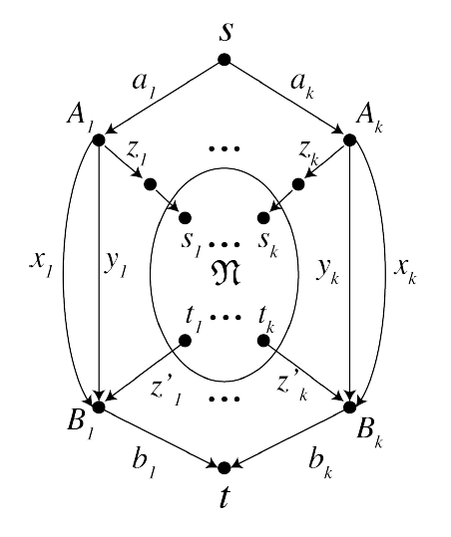
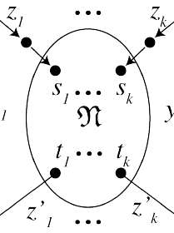
Results
s
t
Study: acyclic networks, single source, single terminal, adversary controls single link, edges have unit capacities; some edges cannot be jammed.
Show: computing capacity is as hard as computing the capacity of Multiple Unicast Network Coding.
Proof: by reduction

Slide 27
What next?
Computing error correcting capacity is as hard as computing the capacity of MU Network Coding.
  Present proof ideas for zero error communication.
  Subtleties for standard communication (asymptotic error, asymptotic rate).

Slide 28
Zero error case
Computing capacity is as hard as computing the capacity of Multiple Unicast Network Coding.
Input: MU NC problem N.
Q: is rate tuple (1,1,…,1) achievable w/ 0 error?
Reduction: construct new network N’.
Can jam any single link except links leaving s and entering t.
Thm: (1,1,…,1) achievable on N iff rate k is achievable on N’.
N’

Slide 29
Zero error case
Computing capacity is as hard as computing the capacity of Multiple Unicast Network Coding.
Can jam any single link except links leaving s and entering t.
Thm: (1,1,…,1) achievable on N iff rate k is achievable on N’.
Assume (1,1,…,1) on N.
Source sends info. on links a_{i}.
One error may occur.
B_{i} decodes based on majority.
Single error will not corrupt.
Rate k is possible on N’.

Slide 30
Zero error case
Corresponds to M₁.
Corresponds to M₂.
Computing capacity is as hard as computing the capacity of Multiple Unicast Network Coding.
Can jam any single link except links leaving s and entering t.
Thm: (1,1,…,1) achievable on N iff rate k is achievable on N’.
Assume rate k achievable on N’.
Want to show (1,1,…,1) on N.
Operating at full rate (cut set): 1-1 between message M; a₁…a_{k}; b₁…b_{k}
Claim (error correction): For M₁≠M₂, if b_{i}(M₁)≠b_{i}(M₂) then:
  z_{i}’(M₁)≠z_{i}’(M₂).
M

Slide 31
Zero error case
Corresponds to M₁.
Corresponds to M₂.
M₁ transmitted + error on x₁.
M₂ transmitted + error on y₁.
Cut value is equal!
B₁ cannot distinguish between M₁ and M₂.
Computing capacity is as hard as computing the capacity of Multiple Unicast Network Coding.
Assume rate k achievable on N’.
Want to show (1,1,…,1) on N.
Operating at full rate (cut set): 1-1 between message M; a₁…a_{k}; b₁…b_{k}
Claim (error correction): For M₁≠M₂, if b_{i}(M₁)≠b_{i}(M₂):
  z_{i}’(M₁)≠z_{i}’(M₂).
  Assume otherwise: z_{i}’(M₁)=z_{i}’(M₂).
  Consider 2 settings.
  Terminal cannot distinguish between M₁ and M₂.
  1-1 correspondence between b_{i} – z’_{i}.

Slide 32
Zero error case
Computing capacity is as hard as computing the capacity of Multiple Unicast Network Coding.
Assume rate k achievable on N’.
Want to show (1,1,…,1) on N.
Operating at full rate: 1-1 between message M; a₁…a_{k}; b₁…b_{k}
1-1 correspondence between b_{i} – z’_{i}
Same technique: 1-1 correspondence between a_{i}-x_{i}-y_{i}-z_{i}
Also 1-1 correspondence b_{i}- x_{i}.
All in all: 1-1 between z_{i}-x_{i}-b_{i}-z’_{i}.
Implies connection z_{i}-z_{i}’: Multiple Uni.

Slide 33
Network equivalence
First explicit reductive paradigm to network communication [Koetter Effros Médard].
“Simple” network : replace individual independent memoryless components by corresponding noiseless components (i.e., Network Coding).
N_{in}
N_{out}
N
“simple” network
“complex” network
“simple” network

Slide 34
Example: upper bound
Replace independent memoryless (noisy) components by upper bounding noiseless components.
Replace noisy component by Network Coding component .
Prove: any rate tuple R in capacity region of original network is also in that of upper bounding network.
N
N_{out}
“complex” network
“simple” network

Slide 35
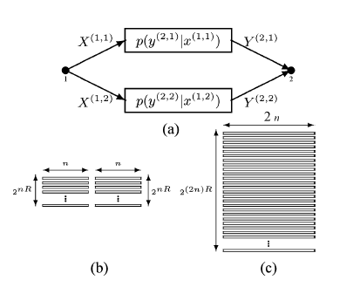
What is known?
Nevertheless: for point to point channels:
Preserving component-wise communication Network Emulation
Point to point channels [Koetter Effros Médard].
  If is a noisy point to point channel than it can be replaced with a “bit pipe” of corresponding capacity.
May sound intuitive but definitely not trivial!:
  Must prove that any coding scheme that allows comm. on N can be converted to one for N_{out}: End to end Network Emulation.
  Must take into account that the link may appear in middle of network and its output could be used in “crazy” ways.
  Reliable communication over N does not imply reliable communication over all components of N.
[Koetter Effros Médard]
N
N_{out}

Slide 36
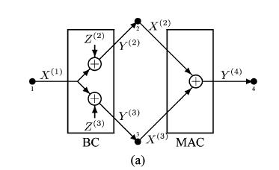
What is known?
Multiple source/terminal channels:
  What if is, e.g., a broadcast channel?
In this case (and others) it is known that preserving component-wise communication does not suffice for network emulation.
Major question: Which properties are needed from the bounding component to allow network emulation?
[Koetter Effros Médard]
N
N_{out}
Y₁
Y₁
X
X
Y₂
Y₂

Slide 37
Examples

Slide 38
[HoEffrosJalali]
Assume rate (R₁,…,R_{k}) is achievable on network N.
Consider network N\e without edge e of capacity δ.
What can be said regarding the achievable rate on the new network?
The edge removal problem
What is the guarantee on loss in rate when experiencing link failure?
S₁
T₁
S₂
e
T₂
N
S₃
T₃
S₄
T₄
S₁
T₁
S₂
e
T₂
N\e
S₃
T₃
S₄
T₄

Slide 39
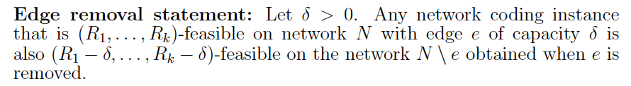
Edge removal
S₁
T₁
S₂
e
T₂
S₃
T₃
S₄
T₄
What is the loss in rate when removing a δ capacity edge?
There exist simple instances in which removing an edge of capacity δ will decrease each rate by an additive δ.
  E.g.: the butterfly with bottleneck consisting of 1/δ edges of capacity δ.
What is the “price of edge removal” in general?
S₁
T₂
S₁
S₁
R=(1,1) is achievable
S₁+S₂
S₂
R=(1-δ,1-δ) is achievable
S₂
S₂
T₁
39

Slide 40
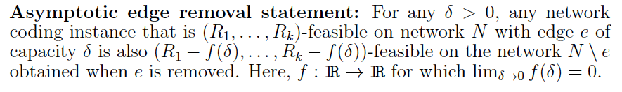
Price of “edge removal”
In several special instances: the removal of a δ capacity edge causes at most an additive δ decrease in rate [HoEffrosJalali].
Multicast: ≤ δ decrease in rate.
Collocated sources: ≤ δ decrease in rate.
Linear codes: ≤ δ decrease in rate.
Is this true for all NC instances?
Is the decrease in rate continuous as a function of δ?
T₁
S_{1,...,}S₄
T₂
N
T₃
T₄
Seemingly simple problem: but currently open.

Slide 41
Edge removal in noisy networks
In the case of noisy networks, the edge removal statement does not hold.
Adversarial noise (jamming):
  Point to point communication.
  Adding a side channel of negligible capacity allows to send a hash of message x between X and Y. Turning list decoding into unique decoding [Guruswami] [Langberg].
  Significant difference in rate when edge removed.
Memoryless noise:
  Multiple access channel:
  Adding edges with negligible capacity allows to significantly increase communication rate [Noorzad Effros Langberg Ho].
X
Y
x
e
y=x+e
X₁
Cooperation facilitator
p(y|x₁x₂)
Y
X₂

Slide 42
What is the price of “edge removal”?
Network coding: not known? Even for relaxed statement.
Challenge, designing code for N given one for N\{e}.
Nevertheless, may study implications if true … or false …even for asymptotic version.
Will show implications on:
  Reliability in network communication.
  Assumed topology of underlying network.
  Assumed demand structure in communication.
  Advantages in cooperation in network communication.

Slide 43
Assume rate (R₁,…,R_{k}) is achievable on network N with some small probability of error ε>0.
What can be said regarding the achievable rate when insisting on zero error?
What is the cost in rate when assuring zero error of communication as opposed to ε error?
1.Reliability: Zero vs ε error
S₁
T₁
S₂
N
T₂
S₃
T₃
S₄
T₄

Slide 44
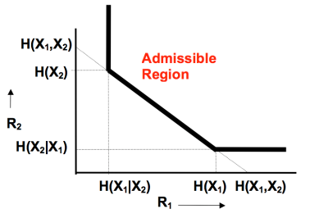
Reliability: Zero vs ε error
Can one obtain higher communication rate when allowing an ε-error, as opposed to zero-error?
In general communication models, when source information is dependent, the answer is YES! [SlepianWolf].
What about the Network Coding scenario in which source information is independent and network is noiseless?
Is there advantage in ε over zero error for general NC?
X₁
[Witsenhausen]
Y
X₂
44

Slide 45

Price of zero error
T₁
S_{1,...,}S₄
T₂
N
T₃
T₄
What’s known:
Multicast: Statement is true [Li Yeung Cai] [Koetter Medard].
Collocated sources: Statement is true [Chan Grant] [Langberg Effros].
Linear codes: Statement is true [Wong Langberg Effros].
Is statement true in general?
Is the loss in rate continuous as a function of ε?

Slide 46
Edge removal ⇔ zero error !
Edge removal is true iff zero~ε error in NC.
Edge removal ⇒ zero error [Chan Grant][Langberg Effros]:
  Assume: Network N is R=(R₁,…R_{k})–feasible with ε error.
  Assume: Asymptotic edge removal holds.
  Prove: Network N is R-δ feasible with zero error.

Slide 47
2. Topology of networks.
Network communication challenging: combines topology with information.
Reduction separates information from topology.
Index Coding has only 1 network node performs encoding.
Recent studies have shown that any network coding instance (NC) can be reduced to a simple instance referred to as index coding (IC). [ElRouayheb Sprintson Georghiades], [Effros ElRouayheb Langberg].
An efficient reduction that allows to solve NC using any scheme to solve IC.
s₁
s₁
s₂
s₃
s₄
s₅
s₆
s₂
NC
IC
t₃
t₁
t₂
t₁
t₂
t₃
t₄
t₅
t₆
Obtain solution to NC
Solve IC

Slide 48
Connecting NC to IC
Reduction in code design: a code for IC corresponds to a code for NC.
s₁
s₁
s₂
s₃
s₄
s₅
s₆
s₂
NC
IC
t₁
t₂
t₁
t₂
t₃
t₄
t₅
t₆
Obtain solution to NC
Solve IC
Theorem: NC is R-feasible iff IC is R’=f(R) -feasible.
Related question: can one determine capacity region of NC with that of IC ?
Surprisingly: currently no!
Reduction breaks down with closure operation.

Slide 49
Connecting NC to IC
s₁
s₁
s₂
s₃
s₄
s₅
s₆
s₂
NC
IC
t₁
t₂
t₁
t₂
t₃
t₄
t₅
t₆
Obtain solution to NC
Solve IC
Theorem: NC is R-feasible iff IC is R’=f(R)-feasible.
Related question: can one determine capacity region of NC with that of IC ?

Slide 50
Edge removal resolves the Q
s₁
s₁
s₂
s₃
s₄
s₅
s₆
s₂
NC
IC
t₁
t₂
t₁
t₂
t₃
t₄
t₅
t₆
[Wong Langberg Effros]
Can determine capacity region of NC with that of IC
50

Slide 51
“Edge removal” implies:
Zero ~ ε error in Network Coding.
Reduction in capacity vs. reduction in code design.
Advantages in cooperation in network communication.
Assumed demand structure in communication.

Slide 52
What can be said regarding the achievable rate
when the source information is independent?
3. Source dependence
What are the rate benefits in shared information/cooperation?
Let N be a directed acyclic multiple unicast network.
Up to now we considered independent sources.
In general, if source information is dependent, it is “easier” to communicate (i.e., cooperation).
Assume rate (R₁,…,R_{k}) is achievable when source information S₁,…,S_{k} is slightly dependent:
S₁
T₁
S₂
T₂
S₃
T₃
S₄
T₄
∑H(S_{i}) - H(S₁,…,S_{k}) ≤ δ

Slide 53
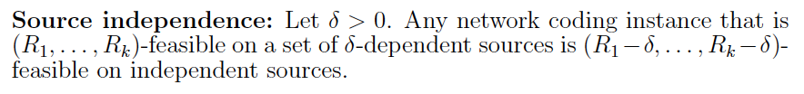
Price of “independence”.
In several cases, there is a limited loss in rate when comparing δ-dependent and independent source information [Langberg Effros].
Multicast: ≤ δ decrease in rate.
Collocated sources: ≤ δ decrease in rate.
Is this true for all NC instances?
Is the decrease in rate continuous as a function of δ?
T₁
S_{1,...,}S₄
T₂
N
T₃
T₄
∑H(S_{i}) - H(S₁,…,S_{k}) ≤ δ

Slide 54
Edge removal ⇔ Source ind.
[Langberg Effros]

Slide 55
“Edge removal” implies:
Zero = ε error in Network Coding.
Reduction in capacity vs. reduction in code design.
Advantages in cooperation in network communication.
Multiple Unicast NC can be reduced to 2 unicast.

Slide 56
4. Network demands
Recent studies have reduced any network commination instance with multiple multicast demands to a multiple unicast instance.
Network Coding [Dougherty Zeger] zero error setting.
Linear Index Coding [Maleki Cadambe Jafar].
General (noisy) networks [Wong Langberg Effros].

Slide 57
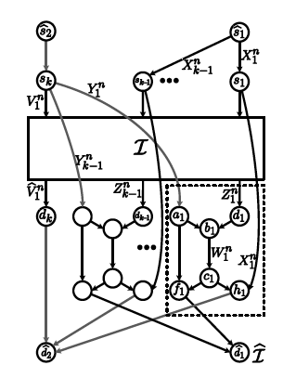
Network demands
For the case of Network Coding one can further reduce to 2 unicast! [Kamath Tse Wang].
Holds only in limited setting of code design (not capacity) and only for zero error.
Can one determine capacity of multiple multicast networks using 2 unicast networks?
Again, reduction breaks down in general setting.
Lets connect to edge removal …

Slide 58
Network demands
The asymptotic edge removal statement is true iff the reduction of [Kamath Tse Wang] holds in capacity.
[Wong Effros Langberg].
NC: multiple multicast capacity can be determined by 2 unicast capacity.

Slide 59
“Edge removal” equivalent:
Zero = ε error in Network Coding.
Reduction in capacity vs. reduction in code design.
Limited dependence in network coding implies limited capacity advantage.
Multiple Unicast NC can be reduced to 2 unicast.
All form of slackness are equivalent.
  Reliability, closure, dependence, edge capacity.

