Slide 1

Efficient storage and search of genome sequence information
Richard Durbin
Wellcome Trust Sanger Institute
rd@sanger.ac.uk
Notes:
----- Meeting Notes (10/10/2012 13:14) -----

Slide 2
The era of sequencing genomes
Size Genes Completion
(Mb) date
H. influenzae 2 1,700 1/1kb Bacterium 1995
Yeast 13 6,000 1/2kb Eukaryotic cell 1996
Nematode 100 18,000 1/6kb Animal 1998
Human 3000 20,000 1/150kb Mammal 2000/3

Slide 3
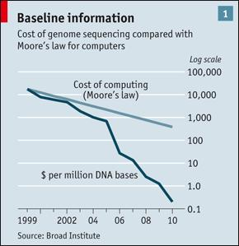
Between 2000 and 2010 DNA sequencing costs dropped by five orders of magnitude
This scaling, now generating PB data per year, challenges data analysis

Slide 4
We can now study genetic variation directly by sequencing
2000: First human genome ~$1 billion
2009: ~200 human genomes sequenced
  Human genome $50k
2012/13: Thousands of genomes for research
  Human genome <$5k
2015/16: Human genome < $1k
  Millions of human genomes for clinical usage, research, personal interest
We need to use the structure in the data for representation and inference

Slide 5
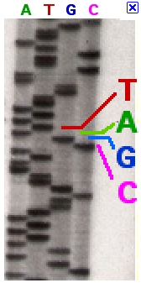
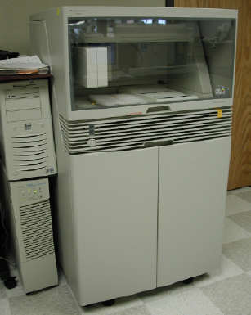
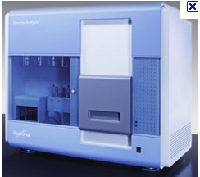
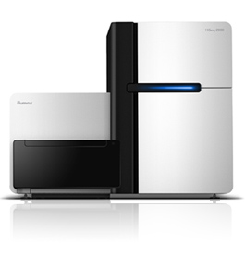
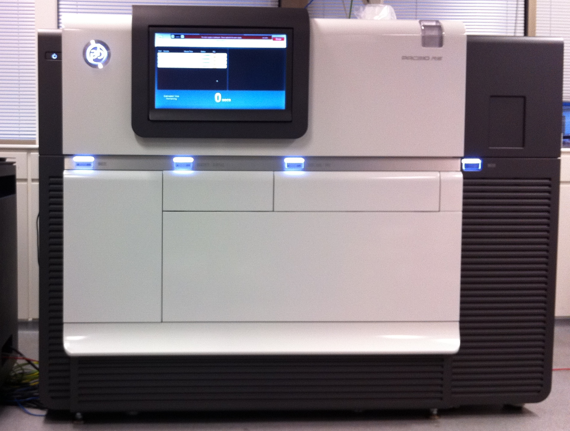
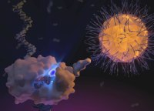
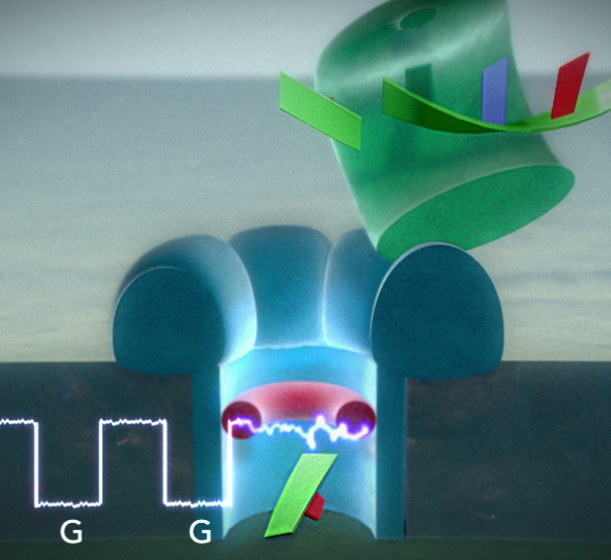
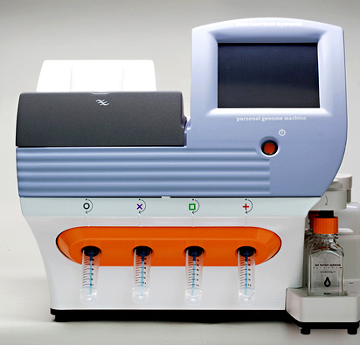
The march of technology
1978-1992
Slab gel (hand)
250bp reads
0.1-5kb kb/run
1992-2007
Capillary
500-1kb reads
10-100 kb/run
2007-10
GA, GAII
35bp reads
10-100 Gb/run
Illumina HiSeq: 2010-15
Initially 75-100bp reads, 300Gb/run
Now 75-250bp reads, 1-2Tb/run
HiSeq X 2014-: 150bp reads, 3.2 Tb/run, $1000/genome
Ion Torrent
Pacific Biosciences
Starlight
Oxford Nanopore

Slide 6
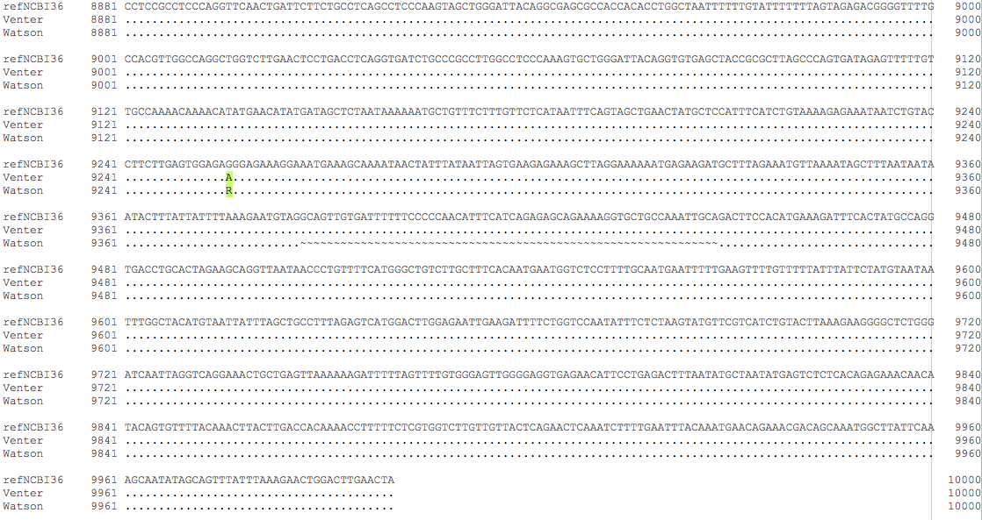
People’s genome sequences are nearly, but not quite the same
1/1000 differences mean 3 million differences
between any two copies
http://www.ensembl.org/Homo_sapiens/Location/SequenceAlignment?db=core;g=ENSG00000187772;r=6:105569758-105579757

Slide 7
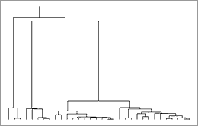
Most genetic variation is shared
At each point in the genome we are descended from a common ancestor
Mutations since the common ancestor give rise to genetic variants with an allele frequency
Some mutations are associated with disease: the frequency in disease cases is different from in controls
By sequencing a sample we can find common variants and their distribution
X
X
X
x
x
x
x
x
x
x
x
x
x
x
x
x
x
x
10%
35%
3%
D
D
D
D
D
D
D
D
D
D
D
Individuals with a specific disease

Slide 8
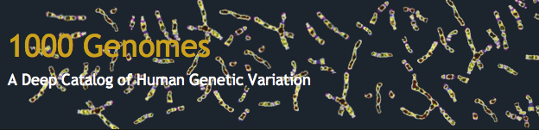
International project to construct a next generation baseline data set for human genetics
  Consortium with multiple centres, platforms, funders
  Conceived in 2007, pilot projects published Oct 2010, phase 1 with 1092 samples published November 2012
Aims
  Find >95% accessible SNPs at allele frequencies above 1%, down towards 0.1% in coding regions
  Genotype them and place on haplotype backgrounds
  Also discover and characterize indels, structural variants
Driver for data and methods

Slide 9


Pilot project 179 samples (Nature 2010)
Phase 1: 1,092 samples 2010/11
Phase 2: 2,500 samples in 2012/13
CEU
FIN
GBR
TSI
CHB
JPT
IBS
PUR
CDX
MXL
YRI
CHS
ASW
PJL
GWD
ACB
KHV
CLM
MSL
ESN
GIH
BEB
ITU
STU
LWK
PEL
~100 per population: 4x Whole Genome Shotgun + Deep Exomes

Slide 10
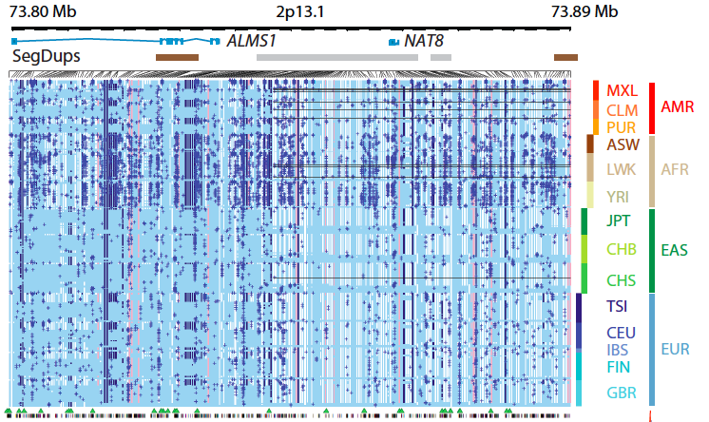
A wealth of data
Call set | Samples | SNPs | Sensitivity (HapMap3.3) | FP (in 59,721 monomorphic OMNI sites) | Genotype accuracy (HapMap 3 hets)
Pilot | 179 | 15.2M | 97.65% | 43,606 | 97.75%
Phase 1 | 1,092 | 38.0M | 98.87% | 1,261 | 99.24%
Phase 3 | 2,523 | ~80M | ~99% |  | ~99.5%
Also integrate many other call types, exome data, CG trios, genotypes…
~70 Tbp sequence

Slide 11
Two core information problems
Processing raw sequencing data
  Matching/alignment of reads or Assembly
  Variant detection
Representing variation in the population
  Use shared ancestral structure
    Tree x Genome -> Ancestral Recombination Graph (ARG)
  The more people we sequence, the more similarity there is to something seen before
  Place individual sequences into ARG or approximation

Slide 12
We want fast algorithms on compressed data
Suffix array/Burrows-Wheeler methods give both
Raw data processing
  Matching (BWA, Bowtie etc.)
  Assembly (SGA)
  Read storage/server (1000G read server)
  Variation detection (SGA-Dindel)
Population variation
  Haplotype analysis and imputation (PBWT)
  (PSMC/MSMC for population inference)

Slide 13
Basic Data Processing Strategy
Collect shotgun sequencing reads
  10⁸ random fragments from the whole genome
  (Can be enriched e.g. genes = 2%: exome)
Map the reads to the reference genome
  Potential problems in repetitive areas
  Potential alignment problems
Detect variants based on the multiple alignment of reads
  Statistical issues allowing for errors and sampling
5 years ago, little of this could be done efficiently, at scale

Slide 14
Read mapping
Need to find inexact matches, with substitutions and insertions/deletions (indels)
Pairwise dynamic programming in 1980s
  O(NM)
Hash based methods to find seed, then extend
  E.g. k-mer exact matches, multi-hit, sparse patterns….

Slide 15
Suffix array: Manber & Myers (1990)
mississippi$
i
SA[i]
0
1
2
3
4
5
6
7
8
9
10
11
11
10
7
4
1
0
9
8
6
3
5
2
$
i$
ippi$
issippi$
ississippi$
mississippi$
pi$
ppi$
sippi$
sissippi$
ssippi$
ssissippi$
Find match by binary search
  sis
O(MlogN) time
  M query
  N target/search space
And O(NlogN) space
  In practice ~10n bytes

Slide 16
Using the BWT and FM-index for matching, as in e.g. bwa or bowtie
Non-unique match is an interval in Suffix Array
mississippi$
i
SA[i]
0
1
2
3
4
5
6
7
8
9
10
11
11
10
7
4
1
0
9
8
6
3
5
2
$
i$
ippi$
issippi$
ississippi$
mississippi$
pi$
ppi$
sippi$
sissippi$
ssippi$
ssissippi$
L(si)=8, U(si)=10
BWT approach to matching:
update L() and U() as you extend the search string
L()=0, U()=12
L(i)=1, U(i)=5
L(si)=8, U(si)=10
Constant time update gives O(M) search
i
si

Slide 17
Update uses index derived from BWT
Ferragina and Manzini 2000
mississippi
i
SA[i]
0
1
2
3
4
5
6
7
8
9
10
11
11
10
7
4
1
0
9
8
6
3
5
2
i
p
s
s
m
$
p
i
s
s
i
i
$
i$
ippi$
issippi$
ississippi$
mississippi$
pi$
ppi$
sippi$
sissippi$
ssippi$
ssissippi$
L(aS) = C[a] + P[a,L(S)]
U(aS) =C[a] + P[a,U(S)]
Where
C[a] is the number of letters less than a in the target string X
P[a,i] is the number of times a occurs in BW[j] for j<i
BW[i] = X[SA[i]-1] is the Burrows-Wheeler transform
BW[i]

Slide 18
We can represent C and P in space N and construct them in time O(N)
i
SA[i]
C[a] is the number of letters less than a in the target string X
C is of size AlogN, so small
BW[i] = X[SA[i]-1]
BW is a permutation of X, size N, constructable in theory from the suffix tree in O(N), in practice O(NlogN)
P[a,i] is the number of times a occurs in BW[j] for j < i
P is size ANlogN, but we can subsample P, e.g. for i a multiple of 128, and calculate intermediate values on the fly from BW. This is the FM index.
0
1
2
3
4
5
6
7
8
9
10
11
11
10
7
4
1
0
9
8
6
3
5
2
i
p
s
s
m
$
p
i
s
s
i
i
$
i$
ippi$
issippi$
ississippi$
mississippi$
pi$
ppi$
sippi$
sissippi$
ssippi$
ssissippi$
BW[i]

Slide 19
FM index searching in practice
Given a query, or set of queries, we can produce a set of SA-intervals (L,U), then treat these as seeds for extension
  Seed length can be chosen dynamically for each hit, with backtrack search to allow errors
A big win is there is no penalty for repetitive sequence
  This just forms bigger intervals in the SA index
BWA (Heng Li) matches query prefix trie to FM index
  Allows mismatches and indels, and keeps suboptimal stats
  BWA-MEM allows subsequence matches on v long seqs
See also BOWTIE, SOAP etc.
Li and Durbin, 2009, 2010; Li 2012 all in Bioinformatics

Slide 20
BWT compression
BWT naturally supports (lossless) compression by run-length encoding of the BWT, naturally compressing repeats
  Basis of bzip, and original motivation for BWT
  Speeds up FM search
Not used by bwa etc., because reference genomes are relatively unique
But metagenomic data, primary shotgun read data, or population sequence sets are very repetitive….

Slide 21
Current read mapping status
BWA (BWT based) is the global standard
  But no longer the fastest (and accurate?)
Modern hash-based mappers can be 10x faster, at the cost of more memory
  e.g. SNAP 60GB index (compare BWA 4GB)
Potential for preprocessing read set?
  E.g. build BWT of reads then merge/align?

Slide 22
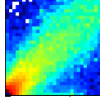
Problems with mapping 1: Repeats
CEU allele frequency
GBR allele frequency
Rare, population specific “SNPs” are clustered near centromere
Many of these are artifacts caused by repeats, e.g. ~1% of the total
Adam Auton

Slide 23
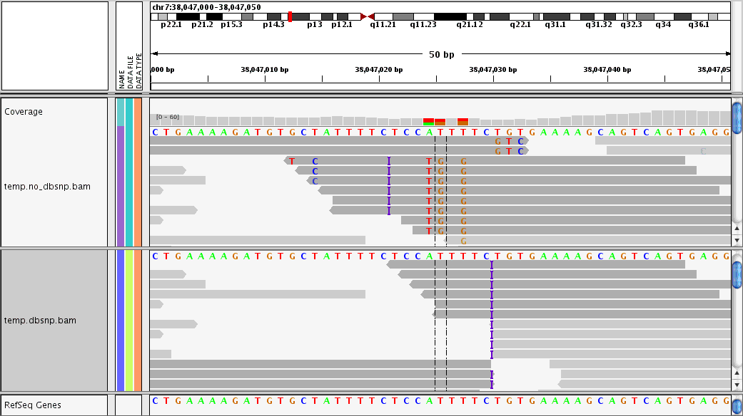
Problem 2: Errors due to alignment at indels
Original BAM
Re-aligned BAM
Control using local alignment uncertainty (BAQ: Li Heng), realignment, reassembly …

Slide 24
We are mapping to the wrong reference!
Genetic variation by assembly
Assembly is the problem of putting the reads together into a genome sequence without knowing the answer, like a jigsaw puzzle
  Not biased by wrong reference
  E.g. minimal superstring formalism
Then align the assembly to the reference to find differences
  Still some problems, but long range alignment is more constrained

Slide 25
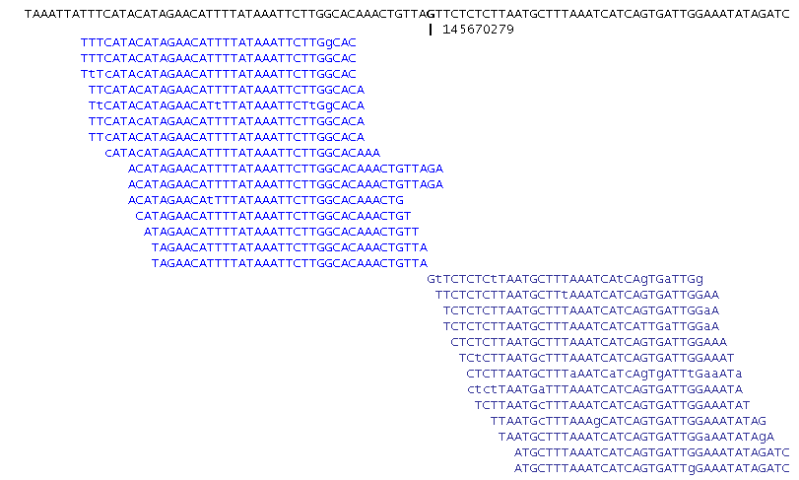
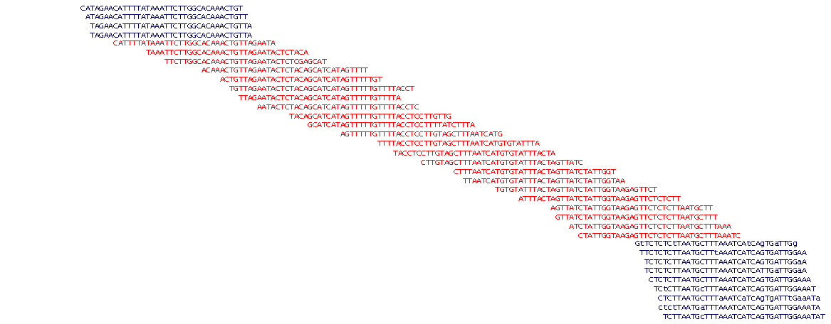
Example of assembly advantages
Mapping reads to reference
De novo assembly

Slide 26
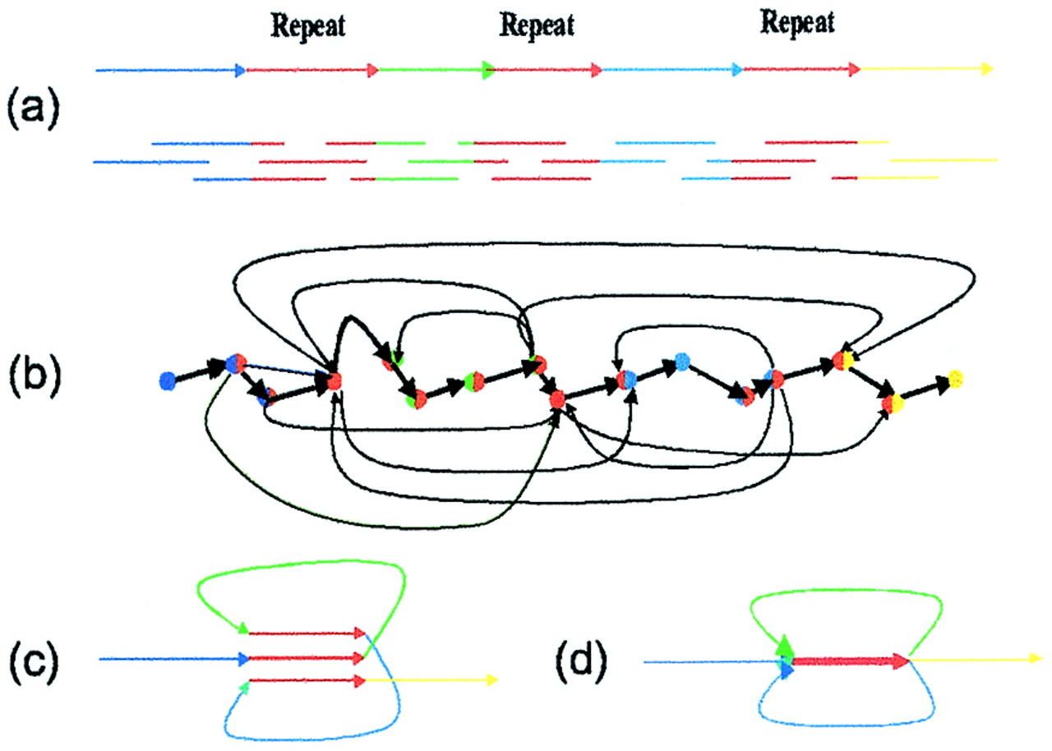
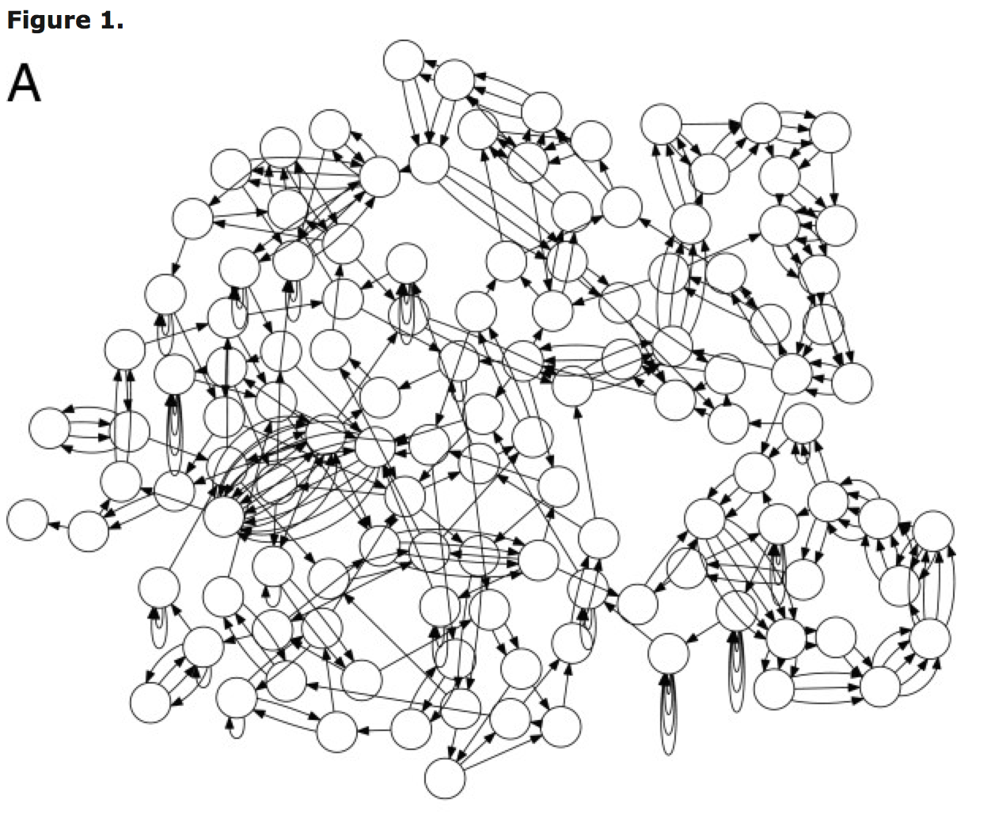
Assembly is also confounded by repeats
(cf regions of same colour in jigsaw puzzle)
General result is assembly graph
E. coli: 4Mb
50bp overlap graph

Slide 27
Using BW/FM index for assembly
Traditional capillary sequence assemblers were based on overlaps between reads
  Heuristic greedy, e.g. Staden, PHRAP (Green)
  Graph-based, e.g. Myers, Pop
  Overlaps are O(N²), or at least O(D²) where D is the depth in repetitive regions
Short read assemblers have been (almost) all based on shared k-mers: de Bruijn graphs
  EULER, VELVET, ABySS, ALLPATHS, SOAP, CORTEX
  Repeats longer than k require post-processing to thread reads through the graph

Slide 28
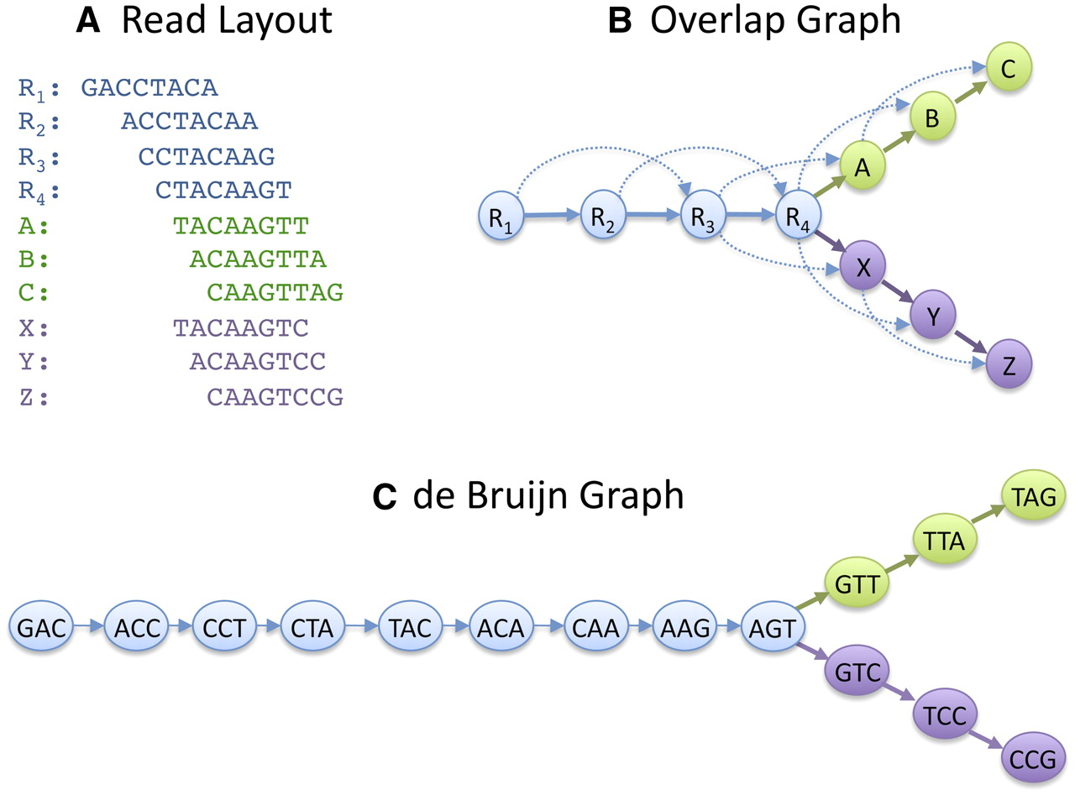

Slide 29
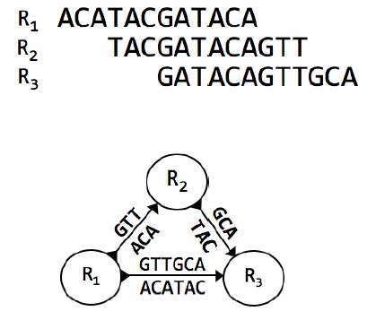
Transitive reduction of overlap graph
Myers string graph approach performs transitive reduction of the overlap graph: nodes are reads, edges are overlaps
The edge R1-R3 is transitive and removed
  Label remaining edges by what they add, so read assembled sequence off edges

Slide 30
R₁ GATACCGTAGA
R₂ TACCGTAGATGC
R₃ GTAGATGCAGT
R₄ AGATGCAGTA
TGC
R₂
AGT
R₃
A
GA
TACC
GT
R₁
R₄
G = GATACCGTAGATGCAGTA
We can compute the non-transitive predecessor/successor nodes for
a read directly from the FM-index of all reads without finding all overlaps
“Efficient construction of an assembly string graph using the FM-index” Simpson and Durbin ISMB 2010

Slide 31
Using BWT/FM index for assembly
The FM-Index of the reads is closely related to an assembly graph
  It efficiently encodes all one base extensions of a k-mer
  It can compute non-transitive overlap structure of the reads and hence string graph unitigs in O(N) time
  Also can derive all de Bruijn graphs for k up to read length
SGA assembler (Jared Simpson)
  Compression of read BWT vastly reduces memory usage
Open question: is Myers string graph the same as de Bruijn graph after perfect read threading?
“Efficient de novo assembly of large genomes using compressed data structures”, Simpson and Durbin, 2012

Slide 32
Unipath construction in SGA
In fact, SGA goes direct from the FM-index of reads to unipaths in the string graph, without explicitly building the read string graph.
After merging, memory reduces by 20-30x and the resulting unipath graph easily fits in memory. No loss of information.
“Efficient de novo assembly of large genomes using compressed data structures”, Simpson and Durbin, 2012

Slide 33
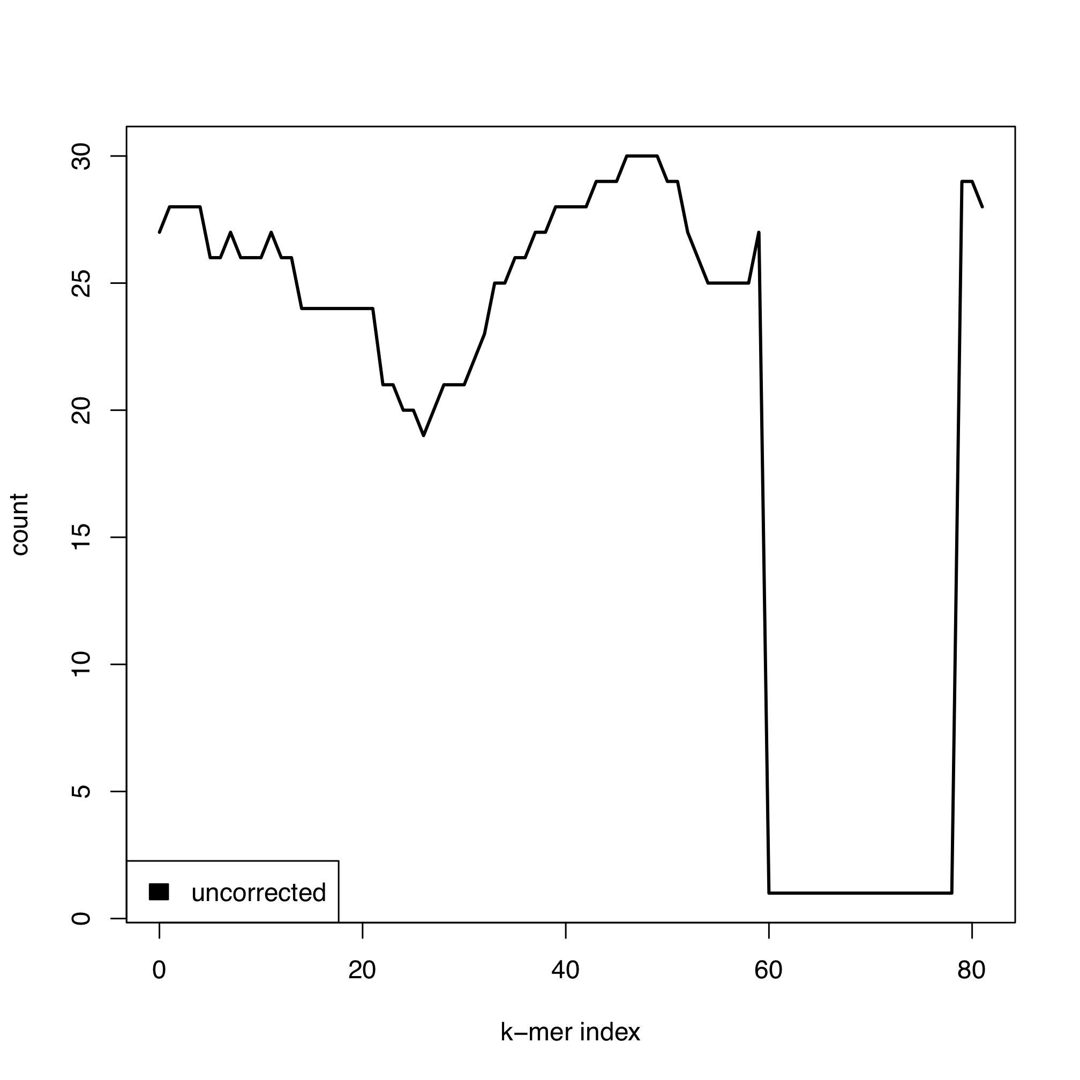
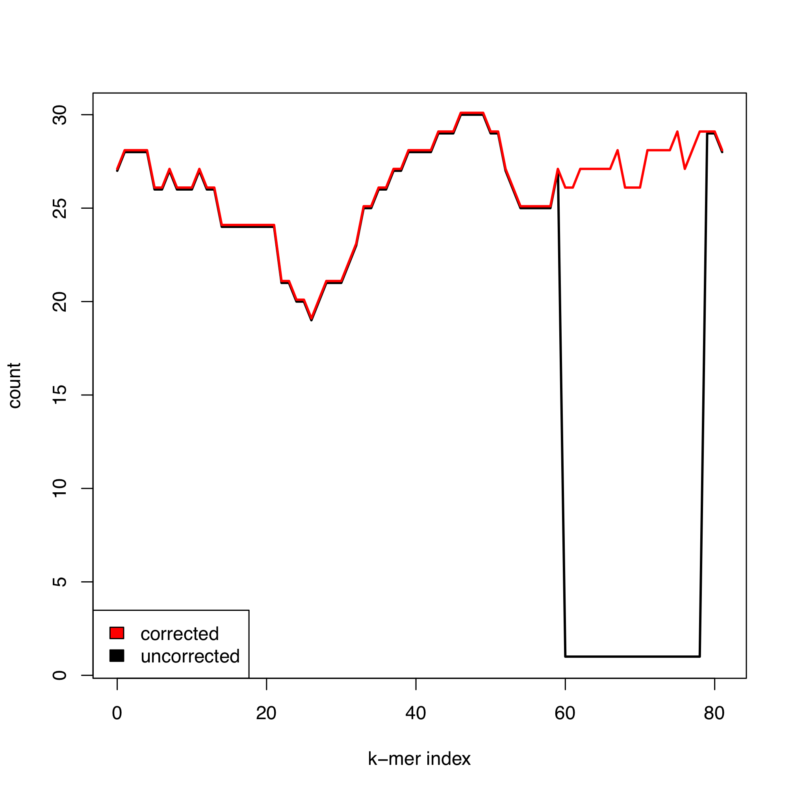
Additional steps
Error correction in reads prior to assembly
Scaffolding using read pairs
Again, use
read
FM-index
2000
contig-221
contig-1948
Place read pairs
with BWA, and
build scaffold graph
75
250
contig-346

Slide 34
SGA performance
Human genome NA12878: 1.2 billion reads (120Gb DNA: 40x)
Stage | Wall Time (Jobs) | Cumulative Time | Max Memory
Index raw reads | 23 hr (123) | 187 CPU-hr | 45 GB
Correct reads | 1 hr (63) | 355 CPU-hr | 28 GB
Index corrected | 32 hr (123) | 355 CPU-hr | 44 GB
Filter reads | 33 hr (1) | 167 CPU-hr | 54 GB
Merge reads | 15 hr (1) | 105 CPU-hr | 48 GB
Assemble reads | 23 hr (3) | 41 CPU-hr | 16 GB
Align to contigs | 6 hr (62) | 210 CPU-hr | 10 GB
Build scaffolds | 7 hr (4) | 7 CPU-hr | 13 GB
All stages | 140 hr | 1427 CPU-hr | 54 GB
Notes:
JS note: I updated this table with the final performance numbers given in the paper

Slide 35
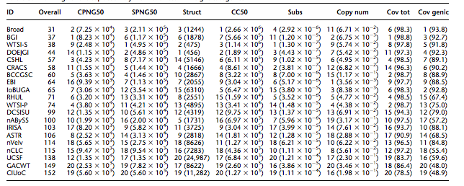
SGA performance
Assemblathon March 2011 UCSC
Not longest contig N50, but fewest substitutions and second fewest mis-assembly errors (longest correct scaffolds)

Slide 36
We are mapping to the wrong reference!
Genetic variation by assembly
Reference free variation detection
  De novo mutations by comparing child to parents
  Somatic cancer mutations by comparing tumour to normal
  Population variation by identifying segregating sequence
  Individual variation by comparing to reference
Could assemble first then compare contig sets
  Time consuming
We only want to assemble the differences between the samples

Slide 37
Genetic variation by assembly
Find unique reads/k-mers, then locally construct the string graph around reads containing these k-mers
Complexity depends on the number of variants
Notes:
Extend the search to other reads that are only present in one set

Slide 38
Genetic variation by assembly
…GATACATACGATCGATCTATGCATCCGAGCTGCTAGCTATCGATT… parent
…GATACATACGATCGATCTATGCATCCGAGCAGCTAGCTATCGATT… child
Evaluate evidence for haplotypes with Dindel (Albers et al. 2010) Bayesian methods
Notes:
Stop the search once the graph has collapsed to shared reads. Parse candidate haplotypes from the graph, align them to reference and test them using probabilistic model.
Worth noting that the level of difference between candidate haplotypes and reference does not matter. Can find indels just as easy as SNPs.

Slide 39
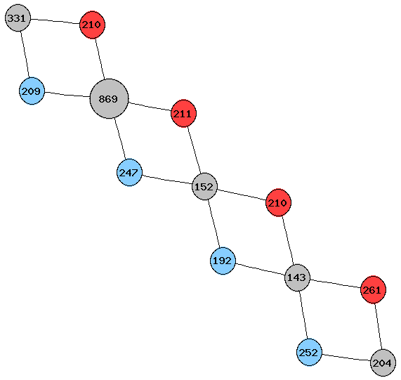
Two yeast strains co-assembled
Shared
DBVPG6044
SK1
…AAAGATATGCGCGTGTGATTGGAGA…
…AAAGATATGCGCATGTGATTGGAGA…

Slide 40
Two yeast strains co-assembled
Shared
DBVPG6044
SK1
CCTTGTGTT----------------------------------------TTAAAT
CCTTGTGTTAGTAATCATATCTTCAGGAAAGCCAAGAACTAATGGCAAATTAAAT
Notes:
40bp insertion/deletion

Slide 41
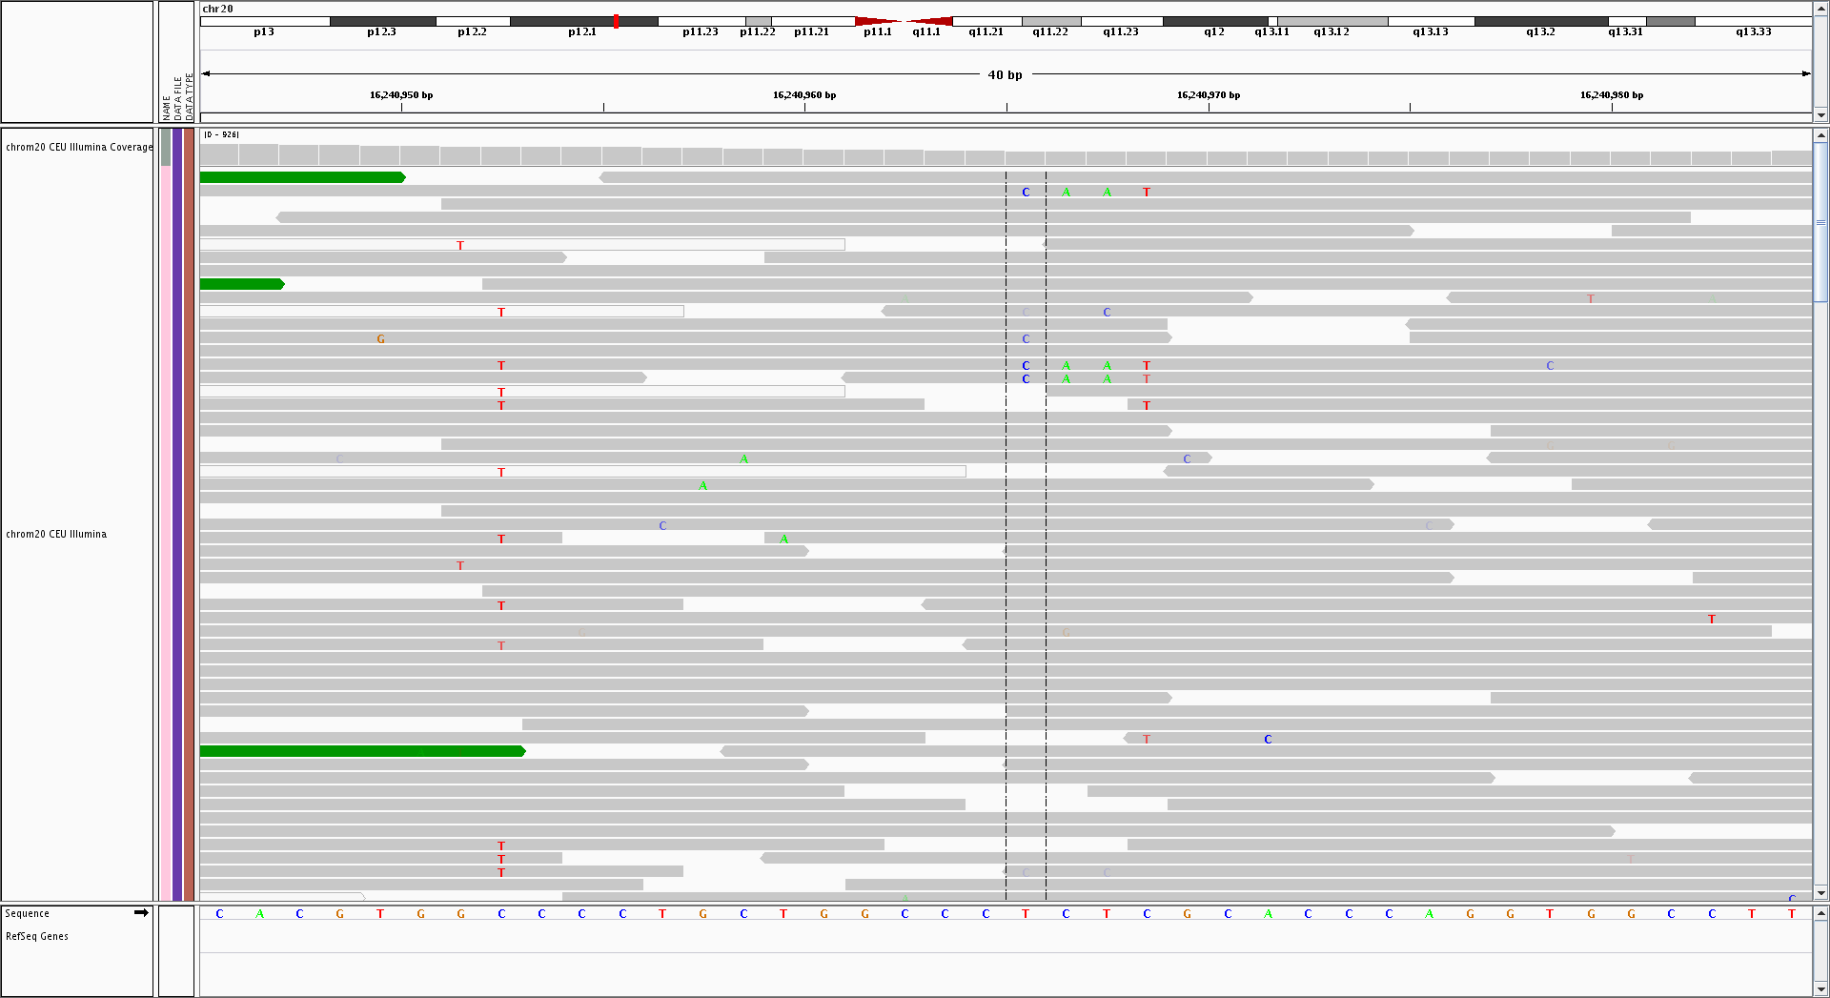
Example from 1000 Genomes: 4bp MNP
20 16240965 . TCTC CAAT 120 PASS AF=0.31894;NumReads=1107;VarDP=43
NB: only 3 reads in mapped BAM: 43 reads in assembly

Slide 42
How far can we go towards reference free analysis?
1000 Genomes Project Read Server
Goal is to build a system to allow queries over the complete set of 1000 Genomes reads
  Which samples contain a given sequence?
  Which reads support a sequence?
  Provide a local assembly across all samples
  Find new strings with sufficient support to define new variants
To support this, we propose to build a full-text searchable index of all the reads
  Enable rapid return all reads containing an arbitrary k-mer
  Secondary index tells us which read is in which sample

Slide 43
Challenges
2,500 individuals, 9x10¹¹ reads, 8x10¹³ bases
  Representation must be super efficient to be in memory
Key ideas to achieve this efficiency
  Use run-length encoded BWT to compress redundancy
  Across the entire read set there will be many exact duplicates for reads from common haplotypes, including matching the reference, so map unique reads
    15,000x coverage = 150 read starts per bp
  Exceptions will be at rare variants, and errors
    Few (<10%) of variant bases are at <5% DAF sites
    We need to remove most errors, but be conservative not to remove true variants

Slide 44
Solution
Error correct reads
  Allow correction only of bases with Q<20 towards known common kmers consistent with the read
  Propose to use Cortex cleaned merged de Bruijn graph
  We could remove kmers seen only once if necessary
Build a compressed BWT of unique reads
  Aim to keep in memory for rapid search
  ?Add temporary reference extensions to reads during building to improve sorting and compression
Build a secondary index of which samples a read is present in, using an efficient key-value retrieval database
  Key is read sequence
  Value is read count per sample information

Slide 45
Problem: Varying read lengths break read sharing
To make our strategy efficient we need error-free reads starting at the same position to be the same
  No good if they are different lengths
But reads vary in length
  Also some reads need quality clipping
Solution: trim reads
  E.g. to 72,100

Slide 46
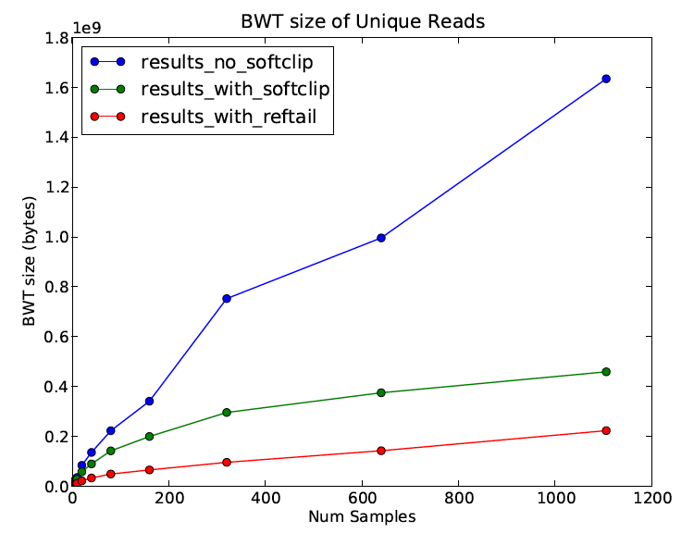
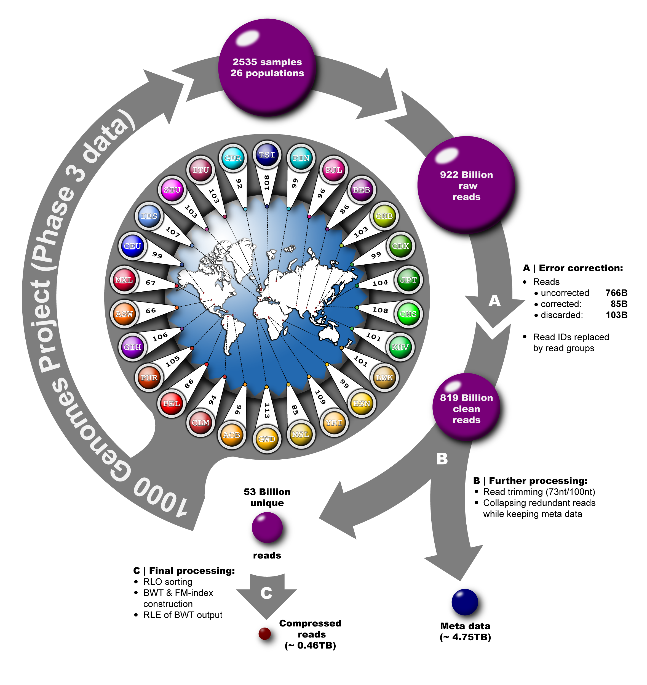
Results: BWT 1000 Genomes Read Server
53 billion unique reads (17x reduction)
  460 GB BWT (0.006 bytes/raw bp)
  4.7 TB metadata RocksDB database

Slide 47

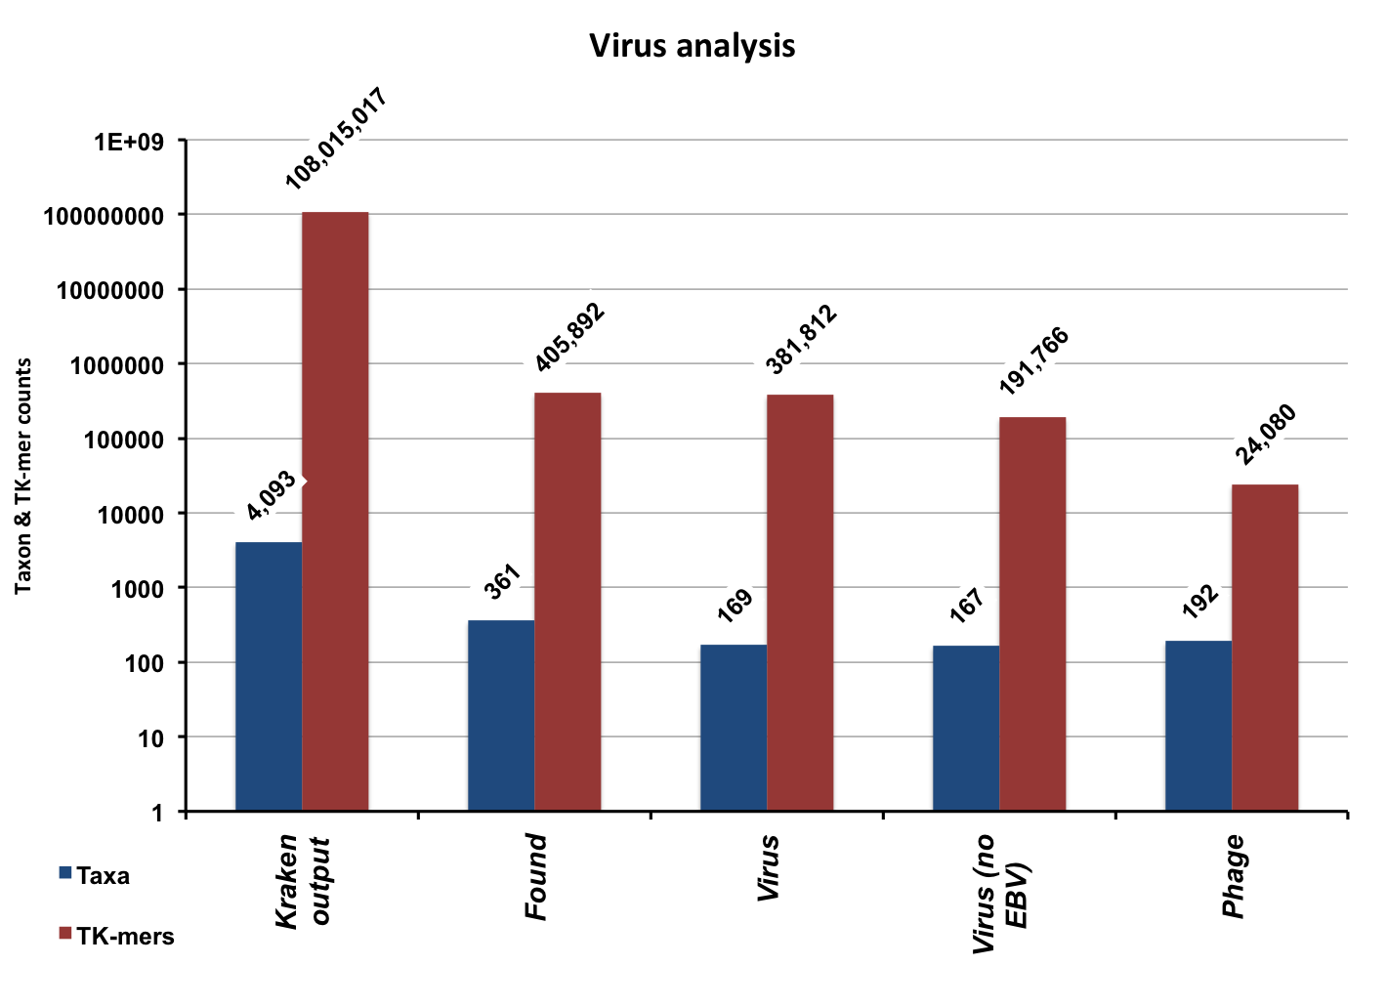
Non-reference sequence:
Search for all 31-mers in any Virus

Slide 48
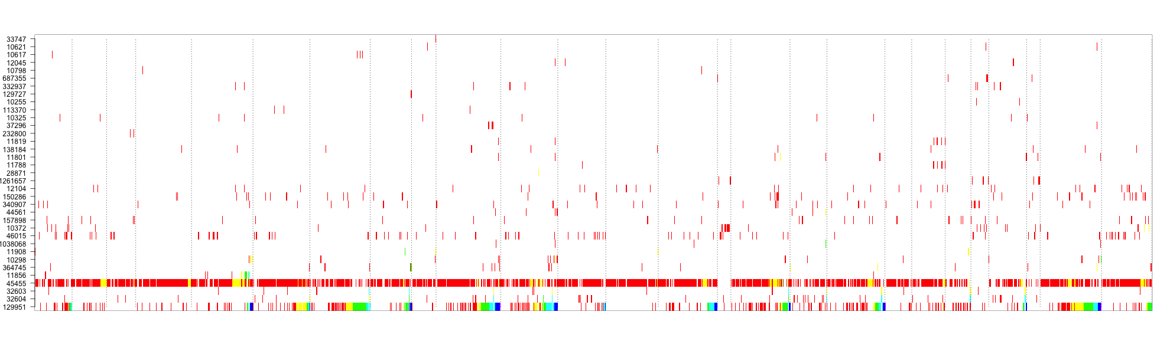
Detected viruses
HPV
TTV
HTLV-1
SMRV

Slide 49
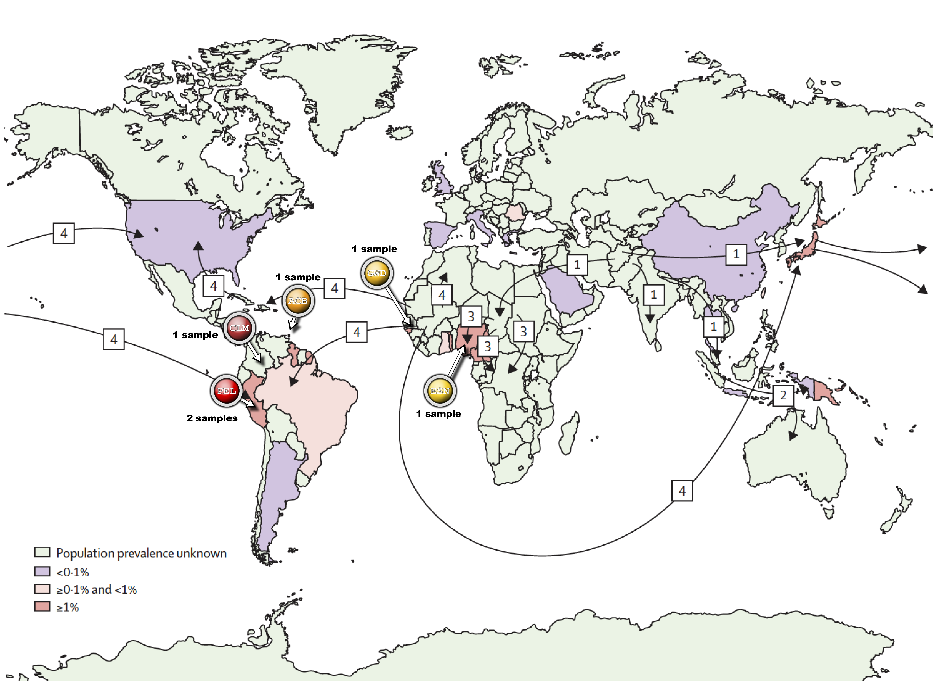
HTLV-1 signatures: Sample origin
Figure adapted from:
Verdonck K, Gonzalez E, Van Dooren S, Vandamme AM, Vanham G, Gotuzzo E. 2007.
Human T-lymphotropic virus 1: recent knowledge about an ancient infection
Lancet Infect Dis, Vol.7

Slide 50
Population variation
At each point in the genome we are related by a tree, descended from a common ancestor
For the Y chromosome, there is just one tree – consider family names
But on the other chromosomes this tree varies along the genome
X
X
X
x
x
x
x
x
x
x
x
x
x
x
x
x
x
x
10%
35%
3%

Slide 51
Sequences are related by a tree at each position on the genome
Mutations on the tree give rise to polymorphic loci
time
(past)
ACCTG...
ACCTG...
Haplotypes
ACCTG...
ACCTG...
The tree changes along the genome
due to ancestral recombination
Notes:
sequences related by many different trees, separated by ancestral recombinations, but unobserved from the data!
Backward-engineering: How to estimate trees from only observing mutations?

Slide 52
Effect of recombination on genealogies: “prune and graft”
time
x
x
Ancestral recombination
Cut branch
“prune”
Re-coalesce
“graft”
New tree
[Sequentially Markovian Coalescent, McVean and Cardin, 2005]

Slide 53
The tree changes along the genome
At each locus there is a tree
Ancestral recombinations change the tree as you move along the genome
The resulting Ancestral Recombination Graph describes the way that individual sequences in a sample are related
a ..C..G..A..
b ..T..G..C..
c ..T..A..A..
d ..T..A..C..
0 0 0
1 0 1
1 1 0
1 1 1
1
3
2
R
a b c d
a b c d
a b c d
a b c d
ARG

Slide 54
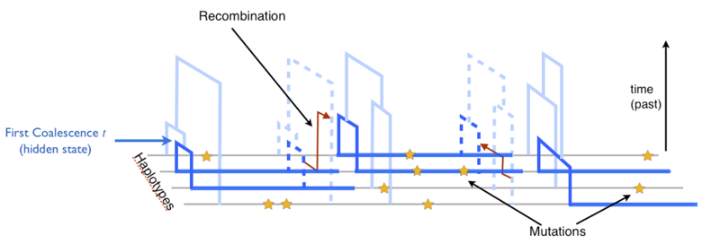
Inference on ARGs is hard
There is a natural generative model for ARGs
  Coalescent with recombination (Kingman, Tavare, Griffiths)
  “Prune and graft” Markovian approximation is very good
But infinitely many ARGs satisfy a data set
  Sampling histories is hard, as is conditional sampling

Slide 55
Alternate approach to representing and using variation
Sequences are related by an ancestral tree, and differ due to mutation and recombination
E.g. 1000s to millions of human genome sequences, or viruses, or bacteria
Consider aligned sequences with variants at a subset of sites
Basis for phasing, imputation etc.

Slide 56
Motivation example: imputation in human genetics studies
a g a g t t g a g g g a a c c t g a g a a
t g a g a c g a g g g a a a t t g a g a c
t g c g a c g g t g a t t c t c c a g a c
a g c g a c g a t g g t a c t t g a t c a
t a a g t t a g t a a t t c c c g a g c a
t g c a a t g a g g g a a a t t g t t a a
a g a g a c g g g g g a a a t t c t g c c
Reference haplotypes via sequencing studies
e.g. 1000 GP, UK10K
g a g g t a a
g c t a t t c
a t g g t t a
g c g g c a a
g c t g t t c
g c g g c a a
g t g g t a c
a t t a c a a
Genotype data from GWAS
e.g. T2D, Arthritis, …

Slide 57
Imputing missing data from reference sequences
a g a g t t g a g g g a a c c t g a g a a
t g a g a c g a g g g a a a t t g a g a c
t g c g a c g g t g a t t c t c c a g a c
a g c g a c g a t g g t a c t t g a t c a
t a a g t t a g t a a t t c c c g a g c a
t g c a a t g a g g g a a a t t g t t a a
a g a g a c g g g g g a a a t t c t g c c
Reference haplotypes via sequencing studies
eg. 1000 Genomes Project
g a g g t a a
g c t a t t c
a t g g t t a
g c g g c a a
g c t g t t c
g c g g c a a
g t g g t a c
a t t a c a a
Imputation of unobserved alleles via matching of shared haplotypes

Slide 58
Imputing missing data from reference sequences
a g a g t t g a g g g a a c c t g a g a a
t g a g a c g a g g g a a a t t g a g a c
t g c g a c g g t g a t t c t c c a g a c
a g c g a c g a t g g t a c t t g a t c a
t a a g t t a g t a a t t c c c g a g c a
t g c a a t g a g g g a a a t t g t t a a
a g a g a c g g g g g a a a t t c t g c c
Reference haplotypes via sequencing studies
eg. 1000 Genomes Project
a g a g t a g a g g g t a c t t g a t c a
t g c g a c g g t g a t t c t t c t g c c
t a a a a t g a g g g a a a t t g t t a a
t g a g a c g a g g g a a c c c g a g c a
a g c g a c g a t g g t a a t t c t g c c
a g a g a c g a g g g a a c c t g a g a a
t g c a a t g a g g g a a a t t g a g a c
t a a g t t a g t a a t t c c t g a t c a
Hidden Markov Model: “select and copy”,
e.g. IMPUTE, MACH
Quadratic methods, also using MCMC.
Will not scale to millions of samples
Imputation of unobserved alleles via matching of shared haplotypes

Slide 59
New data structure for haplotype matching
Positional Burrows-Wheeler Transform PBWT (Bioinformatics, 2014)
PBW[k]
010010101000000111011100100100000000000100010000011000000100100010101000100110000100110000010000100 1 0000000110110010000
010010010110110110011111000101010000100100011000000110000010100011110001000101000100110000010000100 1 1001000001100011110
011010110001000010011100100101010000100100011000000110000010100010001000000111010000010000010100100 1 1001000100100100010
010010010001000010011100010101010000100100011000000110000010100010001000000111010000010000010100100 1 1001000100100100010
011001010001000010011100100110001101000100011010011010000001110010000000100101010100110000100000010 1 0100000100100010010
010001010101000010011111010101010000000100010101101001000000000100010001100100000000000111100000010 1 0100000100100010000
011001010001001100100000010101010000000100010101100000100100100100100111100100000000000111100000010 1 0100000100100010010
110001010001001100011111000101010000100100011000000001000000000011110001000101000000000111100000010 1 0100000010101000010
010010110001000010011000010001010100100100011000100001000100100010000000000101010000110000010000010 0 1000011100100010000
011001010111000010100011010100010000000100010101100000100100100001100001001100000001000000010100010 1 0000100001100010000
011001010110000010101111010101001100000110101000100001000100100100100000100101010100110000110100010 1 0000100001100010010
011001010001000010011100100110100000000110101000100001000100100011110000000101011000010000101100010 0 1000001100000100010
010010010000110010011000010101010000100100011000000000000010100100100000100101010100010000101100010 0 1000101100100000010
011001010001010110011111000101010000100100011000100000000010100100100000100101010100010000101100010 0 1000101100100000010
010010010110110110011111000101011110000000010000000000000100100001100001000100000100010000010110010 0 0000100010110000110
010010010110000010000000010101001010001100101000000110000010000001100001000110100000000110010110010 0 0000100010110000111
000001010010001110011111100100010011000100011000000000100100100001100001000100010000010000100101010 1 0000000110100010000
010010010110110110011100100100000000000100011010011010000001110010010001000111010000110000010010110 0 0100000110110010010
010001010001000010011100100110001101000100011010011010000001110010000000100101010100110000100110011 0 1000000100100000010
010010011010001100011100100101010000100100011000000110000010100100100111000101011100110000010110011 0 1010000010101000000
Reverse sorted prefixes at k
Matches are adjacent in the sort order
Analogous to BWT used by BWA, BowTie etc. for sequence matching

Slide 60


Updating sort order is linear time
Let u_{i} be the number of 0s in y before i, i.e.
And c be the total number of 1s in y, i.e.
Then i maps to u_{i} if y_{i} = 0, and c + i – u_{i} if y_{i} = 1.

Slide 61
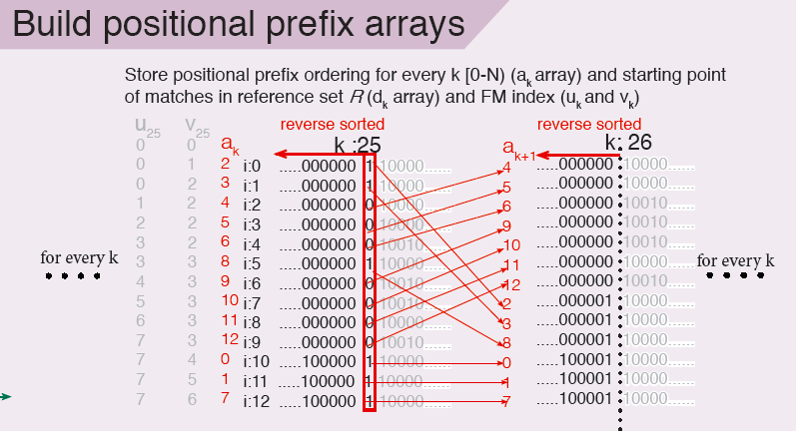
a_{k}[i] is the index in the original sample order of
the i^{th} sequence in reverse prefix order at k
a_{k} is like suffix array index, y_{k} is like BWT

Slide 62
Data compression – run length encoding
Encode runs in bytes using
  1 bit for the value
  2 bits select run length units: 1 or 64 or 2048
  5(6) bits give number of units
Simulate 100k sequences of length 20Mbp with ARG simulator MaCS (Chen et al. 2009)
  370,264 sites (one per 54bp): 37GB raw output
  gzip compresses to 1.02GB (~35x compression)
  PBWT compresses to 7.7MB (~4800x compresssion)
    Native order run length encodes to ~2GB

Slide 63
Compression performance
Simulated data subsets
 | 1000 | 2000 | 5000 | 10000 | 20000 | 50000 | 100000
PBWT | 1685629 | 1956360 | 2783732 | 3372188 | 4145516 | 5688290 | 7697194
haps.gz | 10515008 | 21340464 | 53246970 | 105558782 | 209332249 | 517432833 | 1024614062
factor | 6.2 | 10.9 | 19.1 | 31.3 | 50.5 | 91.0 | 133.1
bytes/site | 4.6 | 5.3 | 7.5 | 9.1 | 11.2 | 15.4 | 20.8
“Real” data: 1000 Genomes phase1 chromosome 1
2184 chromosomes, 3007196 sites
PBWT 51186641
gzip 302883517
factor 5.9

Slide 64
Maximal matches of new sequences to a reference panel
Update rule the same as for sort update
Option 1: build indexes on top of PBWT
  Very fast, effectively independent of the size of the reference panel so O(N) time
  Quite memory hungry, ~13NM bytes
Option 2: match a batch of new sequences as you pass once through the PBWT
  O(NM) time, but very memory efficient

Slide 65
Time to match 1000 new sequences
Reference panel size | 1,000 | 2,000 | 5,000 | 10,000 | 20,000 | 50,000
Naïve | 52.1 | 103.8 | 258.9 | 519.2 | 1035.5 | 2582.6
Indexed | 0.9u 0.1s | 0.9u 0.1s | 0.9u 0.1s | 0.9u 0.2s | 1.1u 0.5s | 1.7u 15s
Batch | 2.3u 0.1s | 2.5u 0.1s | 3.5u 0.1s | 4.8u 0.1s | 6.8u 0.1s | 12.1u 0.1s
The reference panel here is pseudo-genotype array data,
made of 10% of sites with MAF > 0.05 from the full sequence
simulation.
The naïve method compares each sequence to each
previous sequence, efficiently.

Slide 66
What about inference?
Prediction is closely related to compression
Consider a generative model for y given d
e.g. Markov given by p(y_{i+1}| y_{i} ,d_{i})
Iterate to generate whole sequence sets
010010101000000111011100100100000000000100010000011000000100100010101000100110000100110000010000100 1
010010010110110110011111000101010000100100011000000110000010100011110001000101000100110000010000100 1
011010110001000010011100100101010000100100011000000110000010100010001000000111010000010000010100100 1
010010010001000010011100010101010000100100011000000110000010100010001000000111010000010000010100100 1
011001010001000010011100100110001101000100011010011010000001110010000000100101010100110000100000010 1
010001010101000010011111010101010000000100010101101001000000000100010001100100000000000111100000010 1
011001010001001100100000010101010000000100010101100000100100100100100111100100000000000111100000010 1
110001010001001100011111000101010000100100011000000001000000000011110001000101000000000111100000010 1
010010110001000010011000010001010100100100011000100001000100100010000000000101010000110000010000010 0
011001010111000010100011010100010000000100010101100000100100100001100001001100000001000000010100010 1
011001010110000010101111010101001100000110101000100001000100100100100000100101010100110000110100010 1
011001010001000010011100100110100000000110101000100001000100100011110000000101011000010000101100010 0
010010010000110010011000010101010000100100011000000000000010100100100000100101010100010000101100010 0
011001010001010110011111000101010000100100011000100000000010100100100000100101010100010000101100010 0
010010010110110110011111000101011110000000010000000000000100100001100001000100000100010000010110010 0
010010010110000010000000010101001010001100101000000110000010000001100001000110100000000110010110010 0
000001010010001110011111100100010011000100011000000000100100100001100001000100010000010000100101010 1
010010010110110110011100100100000000000100011010011010000001110010010001000111010000110000010010110 0
010001010001000010011100100110001101000100011010011010000001110010000000100101010100110000100110011 0
010010011010001100011100100101010000100100011000000110000010100100100111000101011100110000010110011 0
y
d

Slide 67
Model fit
Log-likelihood of data under model (per cell)
“Leave one out” score
  Sum of scores of each sequence given others
Li and Stephens score for gen1k: 0.058
 | M | N | alpha beta | beta only | pbwt ent | Column ent | pSwitch | av D stick | av D switch
gen1k | 1000 | 5940 | 0.074 | 0.082 | 0.234 | 0.464 | 0.0377 | 270.8 | 49.0
gen2k | 2000 | 5940 | 0.049 | 0.055 | 0.162 | 0.465 | 0.0254 | 399.9 | 69.6
gen5k | 5000 | 5940 | 0.031 | 0.034 | 0.101 | 0.465 | 0.0151 | 603.6 | 111.6
omni4k | 4000 | 54241 | 0.060 | 0.062 | 0.118 | 0.333 | 0.0194 | 5043.0 | 131.1
HRC.1 int | 63156 | 120974 | 0.047 | 0.049 | 0.061 | 0.408 | 0.0098 | 1043.5 | 359.4

Slide 68
Imputation
Task is to infer missing data, given sparse haplotype values
Have tried various methods based on model
Best method is based on maximal matches to reference panel sequences at shared sites
  Weight data at missing sites: w_{i} = L_{i} R_{i}
typically 10-20
  L_{i}
  R_{i}

Slide 69
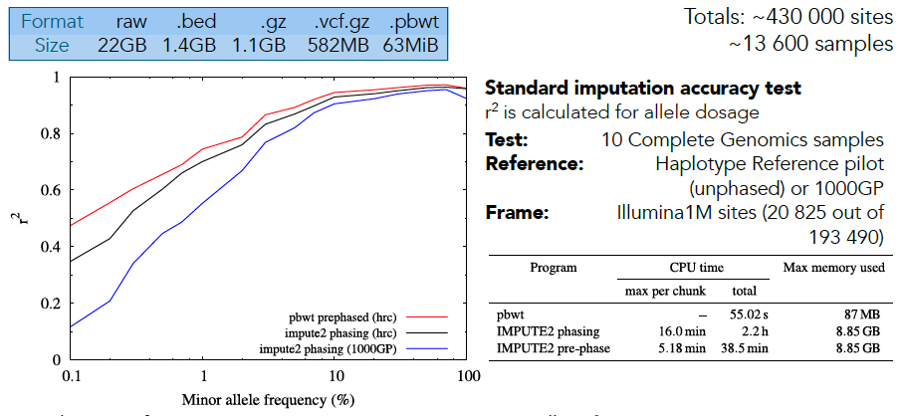
Imputation on Haplotype Reference Consortium pilot (chr20)

Slide 70
Relationship to trees and Ancestral Recombination Graphs
One can define a tree from the d_{i}
But this is not stable to mutations
  Consider singletons move a sequence to the bottom
010010101000000111011100100100000000000100010000011000000100100010101000100110000100110000010000100 1
010010010110110110011111000101010000100100011000000110000010100011110001000101000100110000010000100 1
011010110001000010011100100101010000100100011000000110000010100010001000000111010000010000010100100 1
010010010001000010011100010101010000100100011000000110000010100010001000000111010000010000010100100 1
011001010001000010011100100110001101000100011010011010000001110010000000100101010100110000100000010 1
010001010101000010011111010101010000000100010101101001000000000100010001100100000000000111100000010 1
011001010001001100100000010101010000000100010101100000100100100100100111100100000000000111100000010 1
110001010001001100011111000101010000100100011000000001000000000011110001000101000000000111100000010 1
010010110001000010011000010001010100100100011000100001000100100010000000000101010000110000010000010 0
011001010111000010100011010100010000000100010101100000100100100001100001001100000001000000010100010 1
011001010110000010101111010101001100000110101000100001000100100100100000100101010100110000110100010 1
011001010001000010011100100110100000000110101000100001000100100011110000000101011000010000101100010 0
010010010000110010011000010101010000100100011000000000000010100100100000100101010100010000101100010 0
011001010001010110011111000101010000100100011000100000000010100100100000100101010100010000101100010 0
010010010110110110011111000101011110000000010000000000000100100001100001000100000100010000010110010 0
010010010110000010000000010101001010001100101000000110000010000001100001000110100000000110010110010 0
000001010010001110011111100100010011000100011000000000100100100001100001000100010000010000100101010 1
010010010110110110011100100100000000000100011010011010000001110010010001000111010000110000010010110 0
010001010001000010011100100110001101000100011010011010000001110010000000100101010100110000100110011 0
010010011010001100011100100101010000100100011000000110000010100100100111000101011100110000010110011 0
d

Slide 71
Tree-stable PBWT and
Ancestral Recombination Graphs
Assume 1s are derived and define new update:
  Move 1s together so that at least one 1 is fixed
Without recombination converges to planar sort
Can derive/sample ARG – probabilities not clear
010010101000000111011100100100000000000100010000011000000100100010101000100110000100110000010000100 1
010010010110110110011111000101010000100100011000000110000010100011110001000101000100110000010000100 1
011010110001000010011100100101010000100100011000000110000010100010001000000111010000010000010100100 1
010010010001000010011100010101010000100100011000000110000010100010001000000111010000010000010100100 1
011001010001000010011100100110001101000100011010011010000001110010000000100101010100110000100000010 1
010001010101000010011111010101010000000100010101101001000000000100010001100100000000000111100000010 1
011001010001001100100000010101010000000100010101100000100100100100100111100100000000000111100000010 1
110001010001001100011111000101010000100100011000000001000000000011110001000101000000000111100000010 1
010010110001000010011000010001010100100100011000100001000100100010000000000101010000110000010000010 0
011001010111000010100011010100010000000100010101100000100100100001100001001100000001000000010100010 1
011001010110000010101111010101001100000110101000100001000100100100100000100101010100110000110100010 1
011001010001000010011100100110100000000110101000100001000100100011110000000101011000010000101100010 0
010010010000110010011000010101010000100100011000000000000010100100100000100101010100010000101100010 0
011001010001010110011111000101010000100100011000100000000010100100100000100101010100010000101100010 0
010010010110110110011111000101011110000000010000000000000100100001100001000100000100010000010110010 0
010010010110000010000000010101001010001100101000000110000010000001100001000110100000000110010110010 0
000001010010001110011111100100010011000100011000000000100100100001100001000100010000010000100101010 1
010010010110110110011100100100000000000100011010011010000001110010010001000111010000110000010010110 0
010001010001000010011100100110001101000100011010011010000001110010000000100101010100110000100110011 0
010010011010001100011100100101010000100100011000000110000010100100100111000101011100110000010110011 0

Slide 72
Large scale vision
Can we merge PBWT and BWT assembly?
Build a model from all existing primary data to use efficiently for interpreting new data
  Move away from limited, linear references
  Combine computationally efficient representation with probabilistic model capturing genetic structure
Very large distributed data sets (PB now)
  Global Alliance for Genomics and Health (GA4GH)
Is anyone interested to help? Collaborators, postdocs….

Slide 73
Simplest case: two sequences
(one diploid individual)
Past
The distribution of heterozygous positions in an individual reflects the time to the most recent common ancestor
Mutations
Notes:
To answer this question, we first need to understand what this distribution implies. In fact, the human genome is diploid and the two haplotypes always coalesce some time back in the past. Different regions may have different coalescent time, separated by the ancestral recombinations. Regions that coalesce recently has low heterozygosity and regions that coalesce anciently has high heterozygosity. And so there is a direct link between heterozygosity and regional coalescent time.

Slide 74
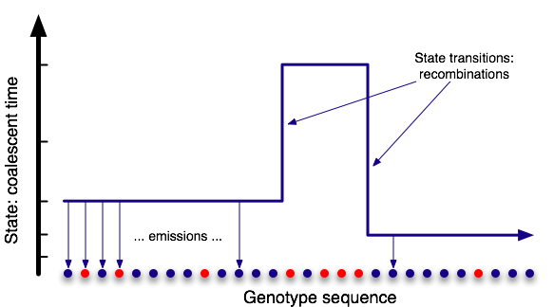
Pairwise Sequentially Markovian Coalescent (PSMC)
Hidden Markov Model
Sequentially Markovian Coalescent
McVean and Cardin, 2005
Heng Li and Durbin, 2011

Slide 75
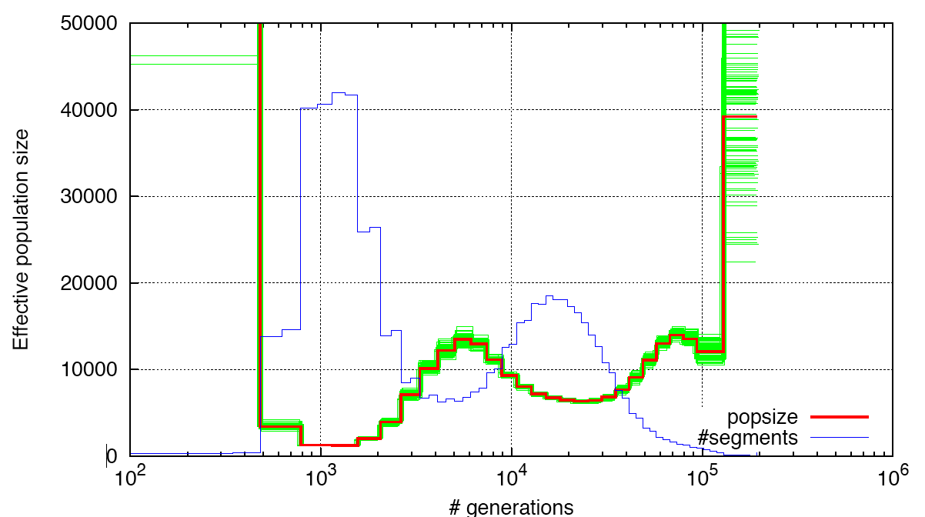
Fitting the model to data: density of coalescent segments is inverse to ancestral (effective) population size
Heng Li and Durbin, 2011

Slide 76
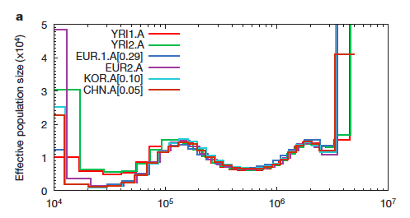
Application to diploid human sequences shows out-of-Africa bottleneck and shared previous history
years ago
But: Inference from only two sequences limited to times beyond 20kya
Also: Assumes single mixing population back through time
Heng Li and Durbin, 2011

Slide 77
Multiple Sequentially Markovian Coalescent (MSMC) – Stephan Schiffels
time
(past)
First Coalescence t (hidden state)
ACCTG...
ACCTG...
Haplotypes
ACCTG...
ACCTG...
Mutations
MSMC HMM hidden state: triple (t, i, j)
time
Transition probabilities from coalescent theory depend on demography
Emission probabilities involve estimation of total tree length and singleton tree length
t
i
j

Slide 78
MSMC: state transitions
(s,k,l) ➔ (t,i,j)
where t<s
s
t<s
k
l
i
j
(s,k,l) ➔ (t,i,j)
where t=s
s
t=s
or
t=s
k
l
i
j
i
j
(s,k,l) ➔ (t,i,j)
where t>s
t>s
s
k
l
i
j

Slide 79
MSMC: mutation probabilities
Total Branchlength T
Singleton Branchlength TS
First Coalescence t
No mutation | 1 - μT | A A A A
Singleton within pair | μ t | A C A A
Singleton outside pair | μ (TS-2t) | A A A T
Double mutation | 0 | A T A T
Higher Frequency | µ (T - TS) | A T T A
Missing Data | 1 | A A - -
Estimate T and Ts regionally

Slide 80
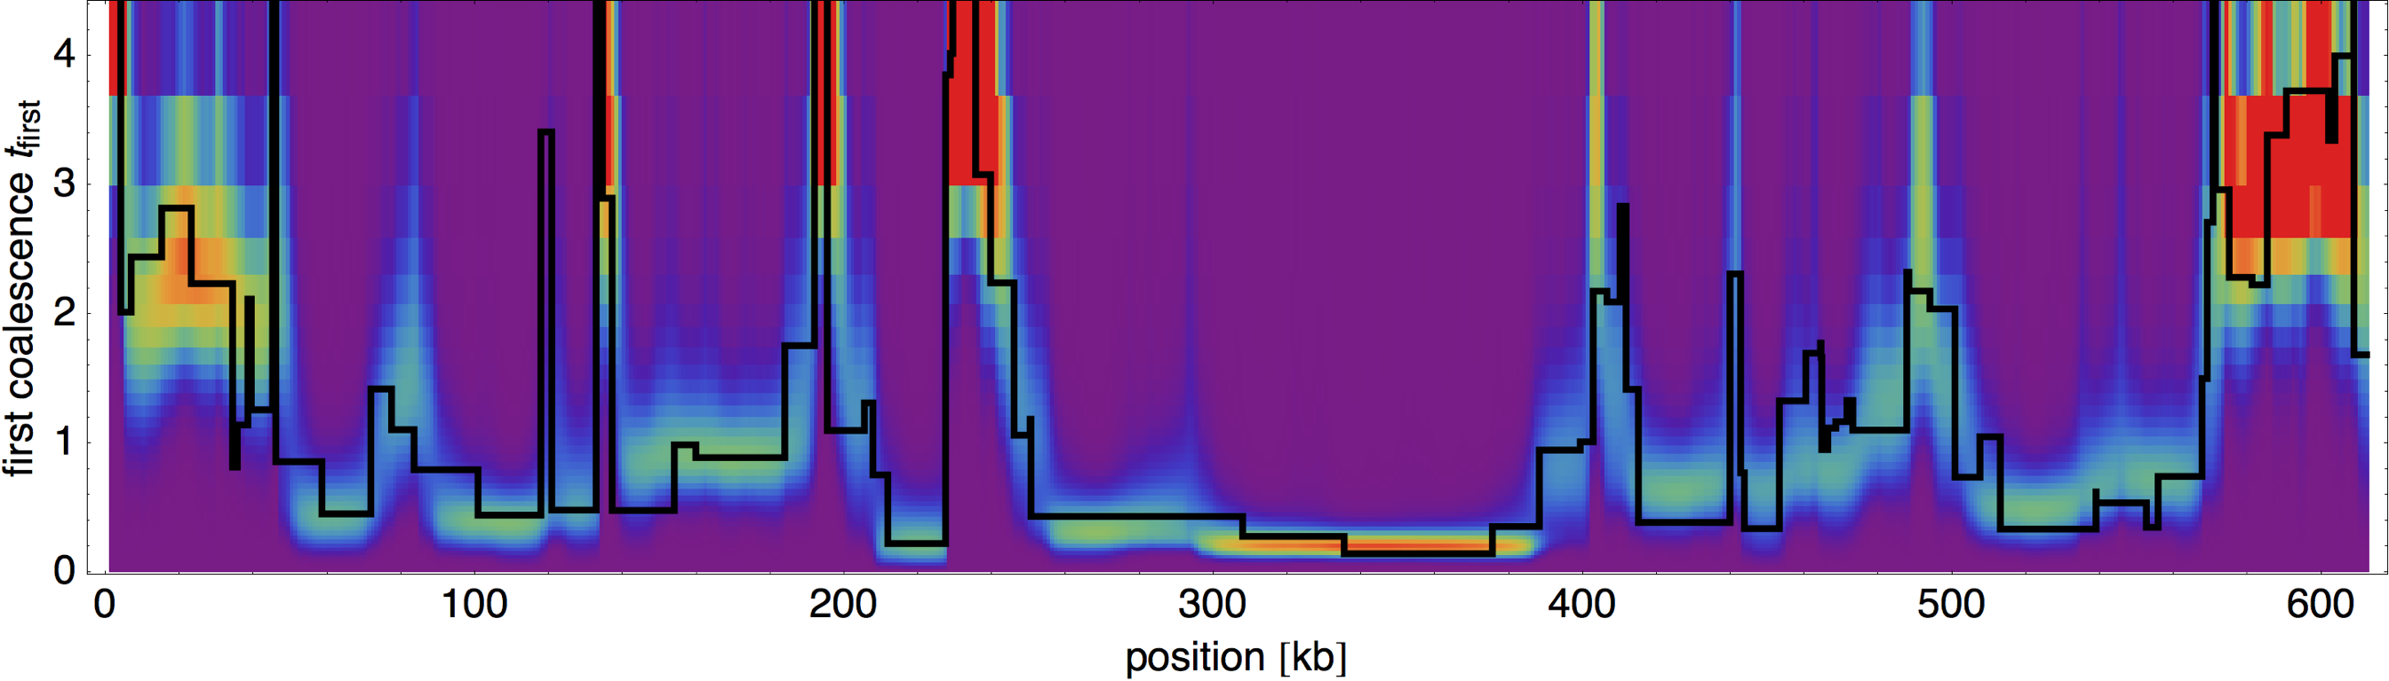
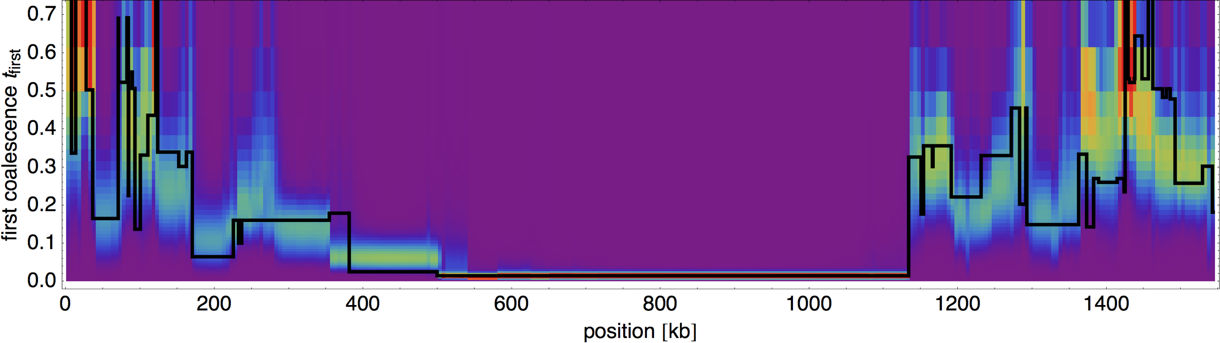
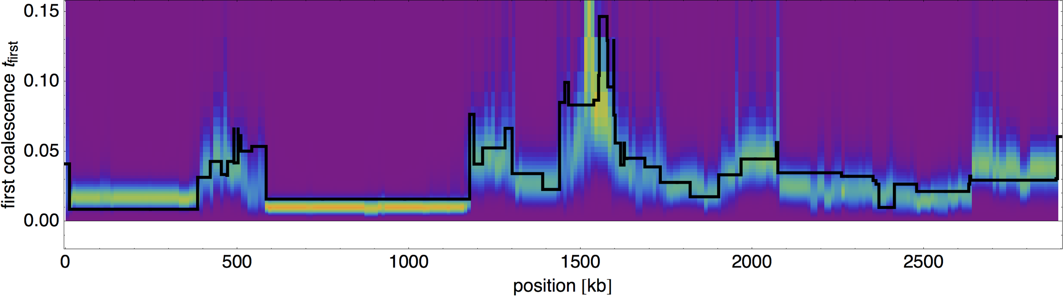
Local Inference of first coalescence time
2 haplotypes,
similar to PSMC
[Li and Durbin, 2011]
4 haplotypes
Note change
in y axis
8 haplotypes

Slide 81
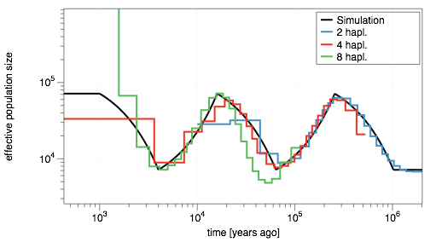
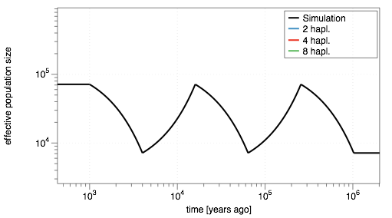
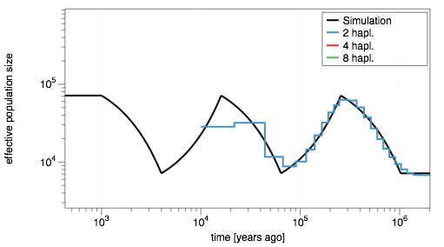
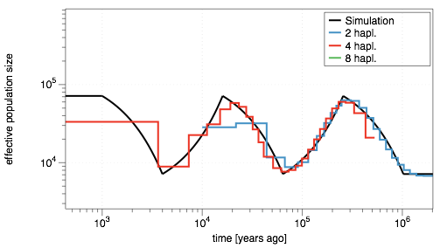
Fit to simulated population history
Example: Exponentially growing and shrinking population size
2 haplotypes: 40kya-1Mya
4 haplotypes: 8kya-300kya
8 haplotypes: 2kya-20kya

Slide 82
Application to human genome sequences
CEU
TSI
CHB
JPT
MXL
YRI
GIH
MKK
LWK
PEL
Deep sequence data on HapMap/1000 Genomes samples from Complete Genomics
Notes:
With genome sequences we can now describe global genetic variation...
What I am most interested in is how this global diversity evolved from an ancestral source population in Africa.
I developed a method with Richard how to derive relationships between genome sequences and hence learn infer our evolutionary past
The tree summarizes our results

Slide 83
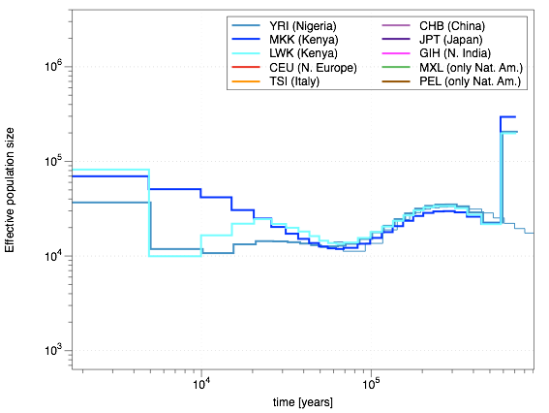
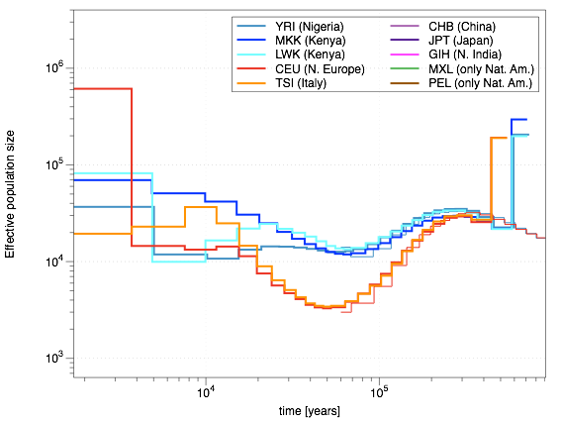
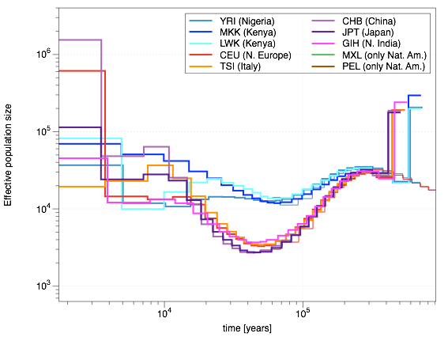
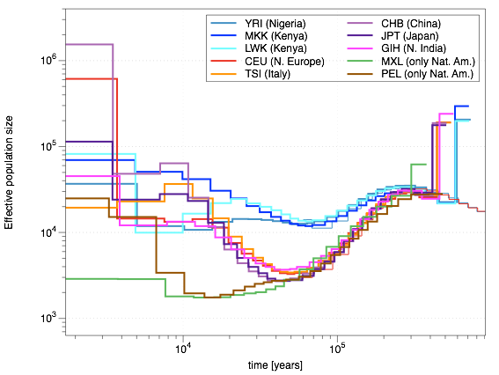
Inferring historical population sizes
real time scaling using
mutation rate per generation µ=1.25×10⁻⁸ and a generation time of 30 years
Mild bottleneck in African ancestors
identical history of non-African populations before 50kya
Complex pattern of neolithic expansions in the last 10,000 years within Europe, Asia and Africa
strong bottleneck in non-African populations 50-60kya, coincides with out-of-Africa dispersal
deep bottleneck in Native American populations around 15kya: Beginning of the Peopling of America via Alaskan Landbridge

Slide 84
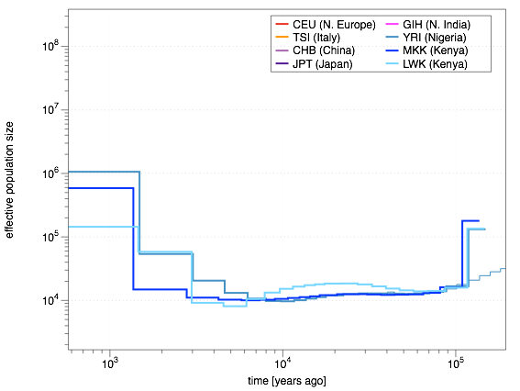
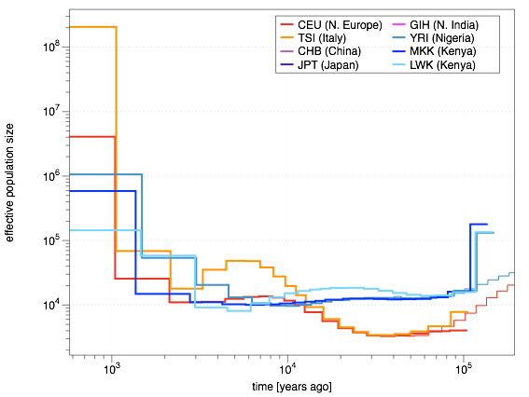

Population size inference from 8 haplotypes
Continuous expansion in Chinese ancestors
Structure and admixture in Southern Europe [see Botigué et al., 2013]
CEU: Constant population size until 2kya, then expansion
Bantu Expansion within Africa?

Slide 85
Divergence between populations
Idea: Infer separate coalescence rates within and between populations:
First Coalescence within Population 1
First Coalescence within Population 2
First Coalescence across both populations
MSMC can infer separate coalescence rates within and between populations
Given rates within populations, λ11(t) and λ22(t), and across populations, λ12(t), compute relative gene flow as ratio
λ12(t)
m(t) =
[λ11(t)+ λ22(t)] / 2

Slide 86

Testing gene flow inference with simulated split
☜ m(t)=1: perfectly mixed
☜ m(t)=0: perfectly split
4 haplotypes: good for splits 50-200kya.
8 haplotypes: good for splits 5-50kya.

Slide 87




African Population separations
African(YRI)/Non-African separation: 150kya-40kya
Masaai remained mixing with European ancestors until ~80kya
Complex splits within Africa: 5kya-30kya

Slide 88




Non-African Population Separations
Splits within Europe and within East-Asia
European/East-Asian split: 30kya, small older component?
Asian/American split: 20kya
Complex Indian separations between 8kya and 20kya

Slide 89

These results used a lower mutation rate µ=1.25x10⁻⁸ / generation
Nat.Am./Asn. split:
10kya ???
Afr/Non-Afr. split: 35kya ???
A higher mutation rate, such as the traditional 2.5×10⁻⁸,
would push these splits towards uncomfortably recent times

Slide 90

MSMC Summary
More direct observation of ancient population history is now possible through ancient DNA
Schiffels and Durbin, in review
Notes:
Putting all the pieces together we get this picture of global human evolution with great detail.
While it is cool to be able to infer all this from present day genomes...
Looking more directly into the past with ancient samples would be very exciting to complete the picture.
We are currently working on getting a first glimpse of this from 2,000 year old British samples.

Slide 91





Late Iron Age samples from Hinxton
12885A, female
12881A, female
12884A, male
12883A, female
12880A, male
Notes:
not only are these samples British, they are as local to the Sanger as it can get.
2,000 years before the Wellcome Trust decided to build one of the world largest sequencing centres,
2 men and 3 women from Roman time Britain were buried under just these grounds
... almost waiting to be found and to be sequenced.
This is what we’re now doing...

Slide 92
Sample Summary
Sample | Cultural Period | Carbon date | endogenous DNA | Coverage
A | Iron Age | 160 BC - 26 AD | 16% | 1.3x
B | Anglo-Saxon | 666 - 770 AD | 36% | 4.4x
C | Anglo-Saxon | 631 - 776 AD | 42% | 3.8x
D | Iron Age | 170 BC - 80 AD | 83% | 11.8x
E | Anglo-Saxon | 690 - 881 AD | 16% | 0.9x

Slide 93

[1000 Genomes Project, Phase 1]
Ancient Samples fall closely with present-day British samples
Little differentiation between ancient samples
Need finer method ☞ Rare variants

Slide 94

Using rare variants to infer demographic history
Rare variants contain information about recent population history and structure
Shown here: number of doubletons shared among European samples
We would like to estimate population split times and population sizes from the frequency of rare variants
CEU
FIN
GBR
IBS
TSI
[1000 Genomes Project, Phase3]

Slide 95

Sharing Patterns between Ancient and modern samples
Difference between Anglo-Saxon and Iron Age sharing with FIN and IBS consistent across different Allele Counts
Small but significant different also within modern Britain: Samples from Southwest (Cornwall) share fewer rare variants with Finnish people.

Slide 96

The rare allele coalescent
Goal: Estimate demographic history (population sizes and split times) from rare variants
Compute likelihood of demographic model given a distribution of rare variants.
time (past)
Pop1
Pop2
Pop3
[Figure from Leliaert et al. 2014]

Slide 97
The rare allele coalescent
Idea: Define recursion equations for probability of observing i derived alleles in population k:
Given a demographic model, propagate this probability backwards in time to get full likelihood of the data.
Key simplification: Treat number of ancestral alleles over time as average (mean-field approximation):
time (past)
Pop1
Pop2
Pop3

Slide 98
Test inference with simulated data
Time (generations)
scaled population sizes
1
0.87
400
388
0.2
0.22
300
299
0.5
0.5
200
200
0.4
0.47
100
92
10
5
2
4
5
10.3
5
2
4
5
Simulated
Estimated
Fits (100 samples per pop.):
Fitting population sizes and split times separates drift from divergence -> different from Treemix
Pattern | Count (real) | Count (predicted)
0,1,0,2,1 | 1114 | 1159
2,1,0,0,0 | 140585 | 139657
1,0,2,0,0 | 1138 | 1205
thousands of rows …

Slide 99
An average European Tree
Time (gen.)
50k
334
46k
Population Sizes
282
14k
236
784k
660k
34k
724k
FIN
GBR
TSI
IBS
Used 341 European samples from the 1000 Genomes project (phase 3)
Fitted demographic history to all rare variants up to allele count 4

Slide 100

European Tree (Fits)
Time (gen.)
50k
334
46k
282
14k
784k
236
660k
34k
724k
FIN
GBR
TSI
IBS

Slide 101



Placing ancient samples on the tree
B
C
D
(Iron Age Sample)
Anglo-Saxon samples
ancient samples can be placed with correctly shortened branches
Finnish location probably reflects northern continental European ancestry (consistent with Anglo-Saxon origin)

Slide 102
Conclusions
From the five ancient samples sequenced:
  the older samples (Iron Age) are very similar to present day British samples,
  the younger samples (Anglo-Saxon) have a clear component from continental northern Europe, consistent with being early immigrants.
  From this, it does not look like the Anglo-Saxons wiped out the existing inhabitants in England.
Rare Variants contain fine-grained demographic information, even at the single sample level.

Slide 103





Acknowledgements
Andrew Brown, Milan Malinsky,
Stephan Schiffels, Vladimir Shchur,
Vagheesh Narasimhan, Zhihao Ding,
Yasin Memari, Jared Simpson,
Heng Li, John Lees
Thomas Keane, Sendu Bala,
Petr Danecek, Shane McCarthy,
core sequencing teams
  ssss

