Slide 1
Information Theory of
High-throughput Shotgun Sequencing
David Tse
Dept. of EECS
U.C. Berkeley
Tel Aviv University
June 4, 2012
Research supported by NSF Center for Science of Information.
Joint work with A. Motahari, G. Bresler, M. Bresler.
Acknowledgements: S. Batzolgou, L. Pachter, Y. Song
TexPoint fonts used in EMF: AAAAAAAAAAAAAAAA

Slide 2
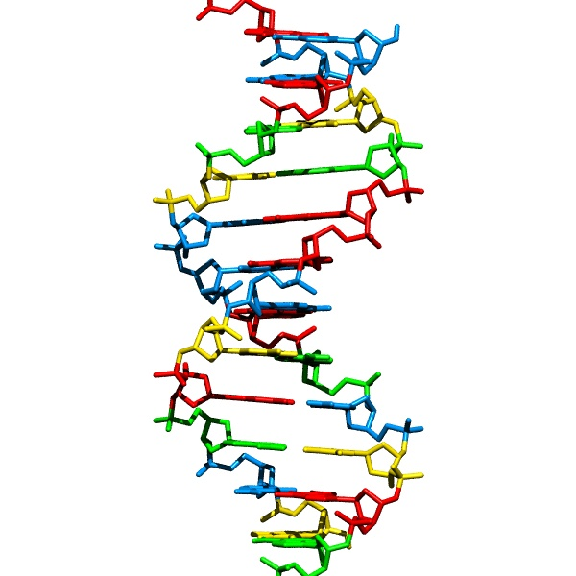
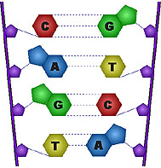
DNA sequencing
DNA: the blueprint of life
Problem: to obtain the sequence of nucleotides.
…ACGTGACTGAGGACCGTG
CGACTGAGACTGACTGGGT
CTAGCTAGACTACGTTTTA
TATATATATACGTCGTCGT
ACTGATGACTAGATTACAG
ACTGATTTAGATACCTGAC
TGATTTTAAAAAAATATT…
courtesy: Batzoglou

Slide 3
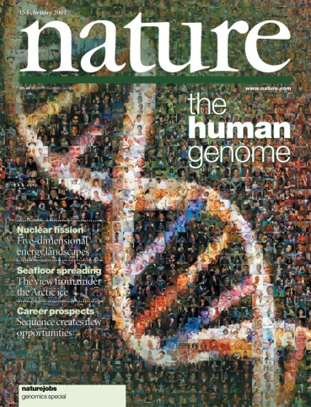
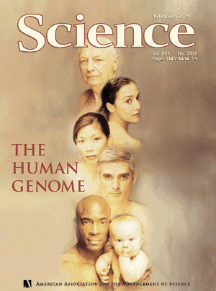
Impetus: Human Genome Project
1990: Start
2001: Draft
3 billion nucleotides
2003: Finished
3 billion $$$$
courtesy: Batzoglou

Slide 4
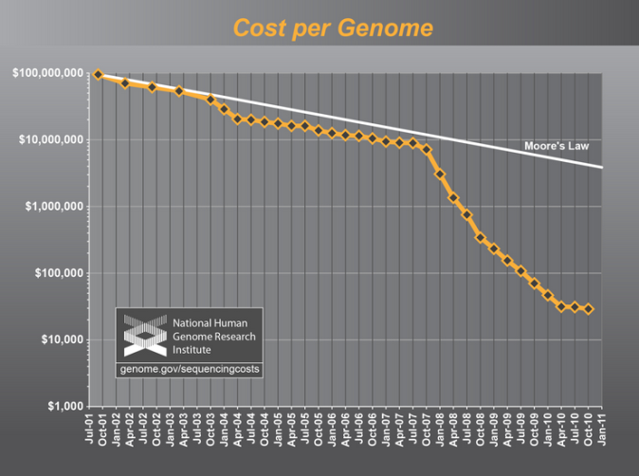
Sequencing gets cheaper and faster
Cost of one human genome
HGP: $ 3 billion
2004: $30,000,000
2008: $100,000
2010: $10,000
2011: $4,000
2012-13: $1,000
???: $300
courtesy: Batzoglou
Time to sequence one genome: years → days
Massive parallelization => high throughput

Slide 5
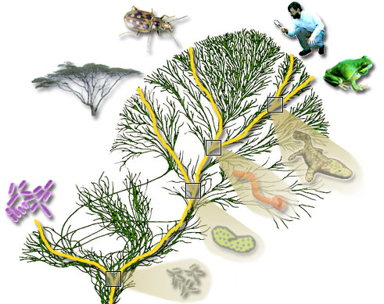
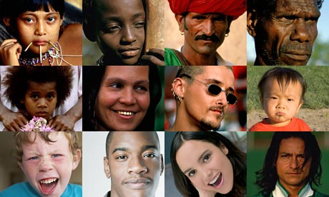
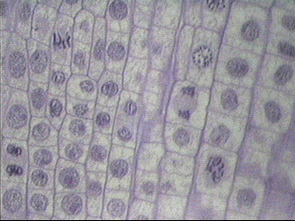
But many genomes to sequence
100 million species
(e.g. phylogeny)
7 billion individuals
(SNP, personal genomics)
10¹³ cells in a human
(e.g. somatic mutations
such as HIV, cancer)
courtesy: Batzoglou

Slide 6
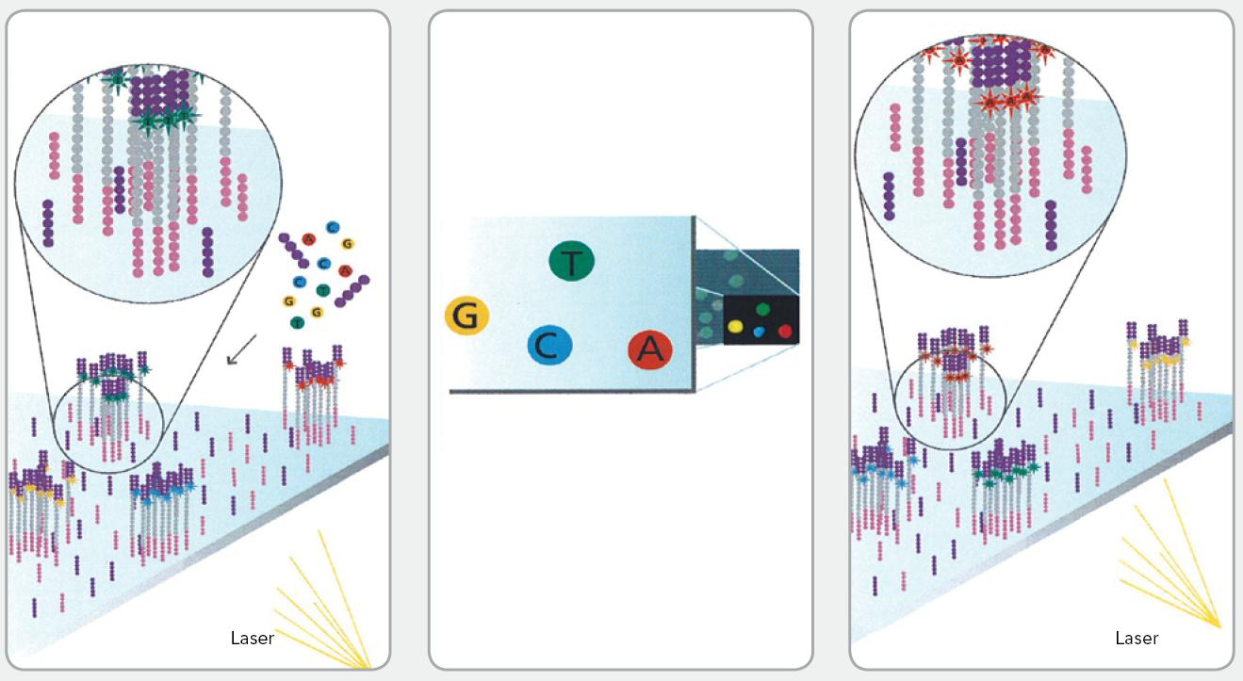
Whole Genome Shotgun Sequencing
to 1000
Reads are assembled to reconstruct the original DNA sequence.
Will focus on de novo assembly in this talk.

Slide 7
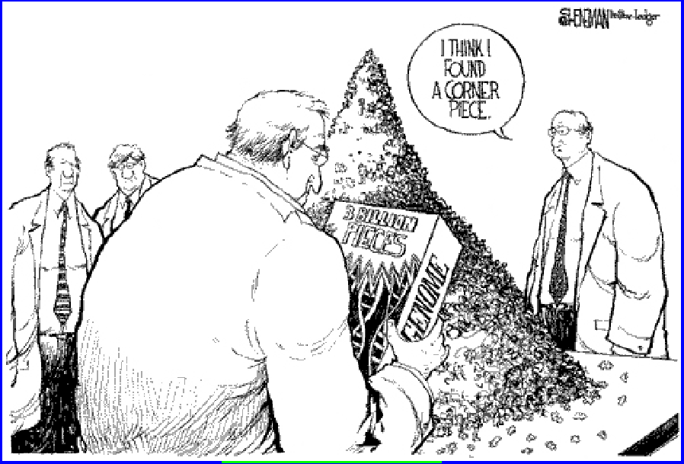
A Gigantic Jigsaw Puzzle

Slide 8
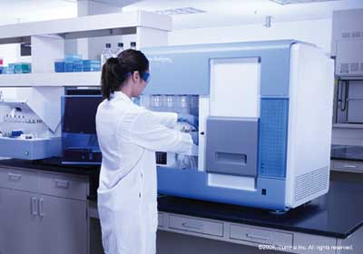
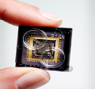
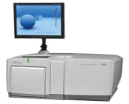
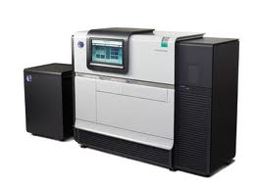
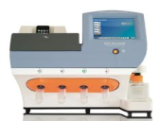
Many Sequencing Technologies
HGP era: single technology (Sanger)
Current: multiple “next generation” technologies (eg. Illumina, SoLiD, Pac Bio, Ion Torrent, etc.)
Each technology has different read lengths, noise profiles, etc

Slide 9
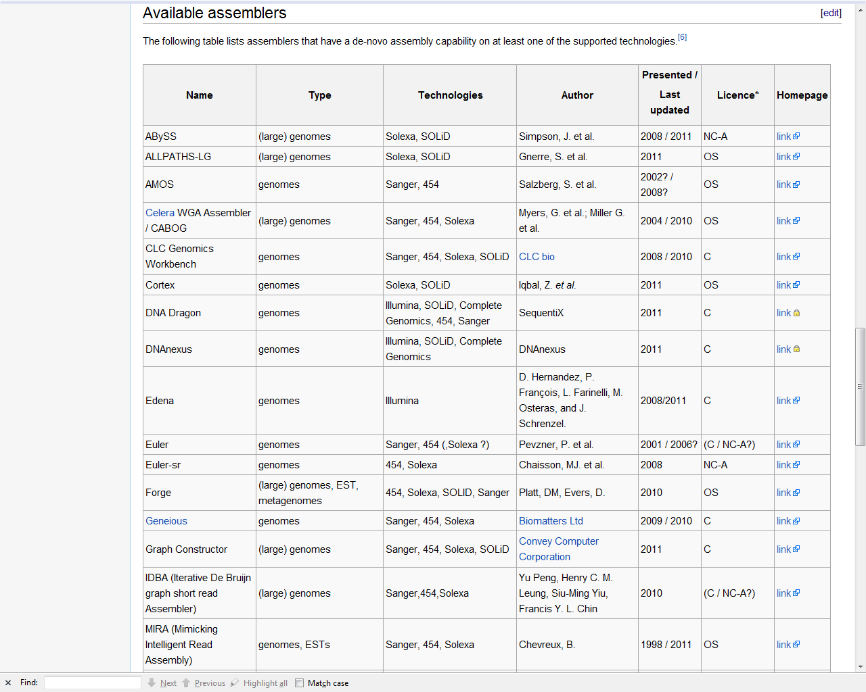
Many assembly algorithms
Source:
Wikipedia

Slide 10
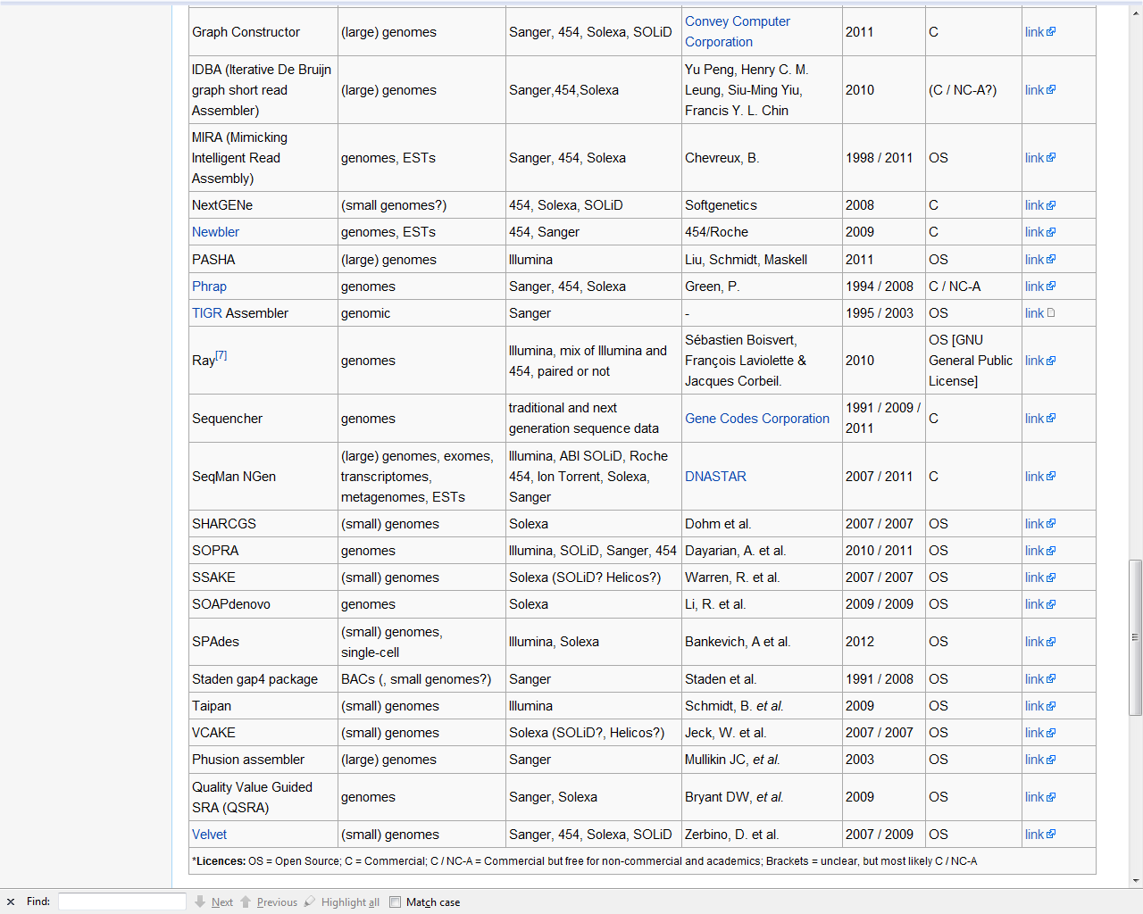
And many more…….
A grand total of 42!
Why is there no single optimal algorithm?

Slide 11
A basic question
What is the minimum number of reads required for reliable reconstruction?
What is an optimal algorithm that achieves this minimum?
A benchmark for comparing different algorithms and different technologies.
Open question!

Slide 12
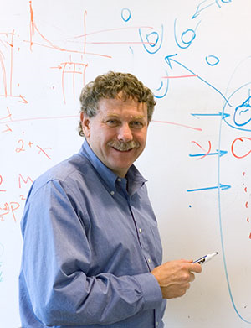
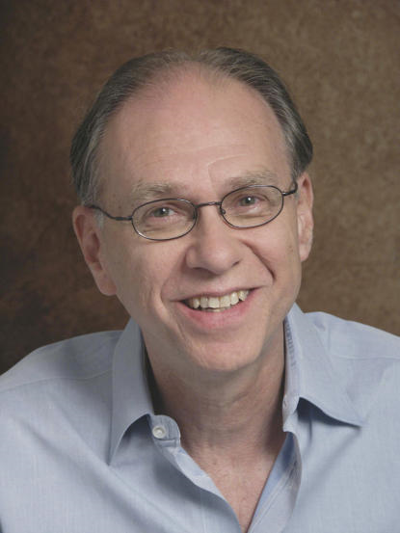
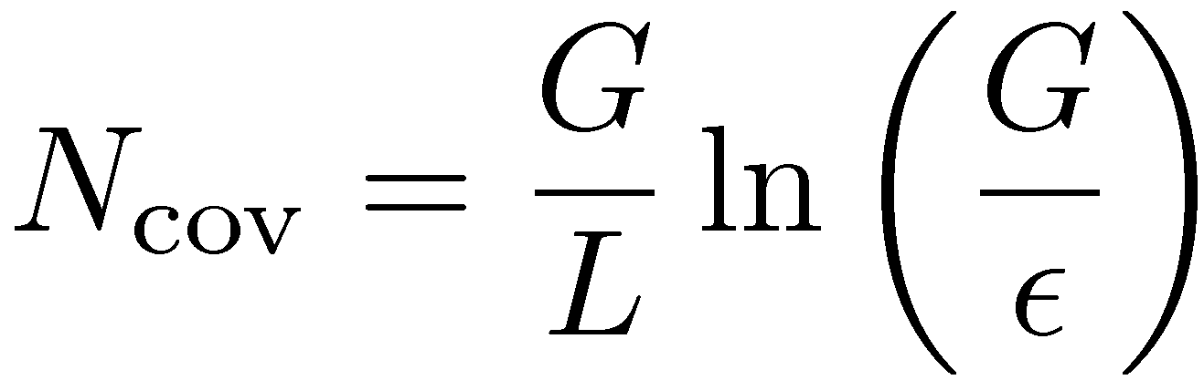
Coverage Analysis
Pioneered by Lander-Waterman
in 1988.
What is the minimum number of reads to ensure there is no gap between the reads with a probability 1-²?
N_{cov} only provides a lower bound on the minimum number of reads.
Clearly not tight.

Slide 13
Communication and Sequencing:
An Analogy
Communication:
Shotgun sequencing:

Slide 14

Communication: Fundamental Limits
Model all sources and channels statistically.
Shannon 48
Theorem:
i.e., asymptotically error free at all rates

Slide 15
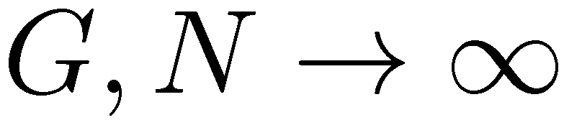
Sequencing: Fundamental Limits
Define: sequencing rate R = G/N nucleotides per read
Question: can one define a sequencing capacity C such that:
asymptotically reliable reconstruction is possible if and only if R < C?

Slide 16
A Basic Model
DNA sequence: i.i.d. with marginal distribution
p=(p₁, p₂, p₃, p₄).
Starting positions of reads: i.i.d. uniform on the DNA sequence.
Read process: noiseless.
Will look at statistics from genomic data and noisy reads later.

Slide 17



A necessary condition for reconstruction
interleaved repeats of length
None of the copies is straddled by a read (unbridged).
Reconstruction is impossible!
Special cases:
Under i.i.d. model, greedy is optimal for mixed reads.

Slide 18
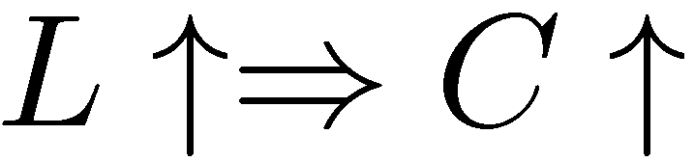
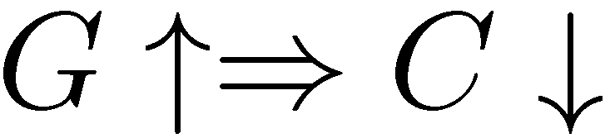
The read channel
Capacity depends on
  read length: L
  DNA length: G
Normalized read length:
Eg. L = 100, G = 3 £ 10⁹ :
read
channel
AGCTTATAGGTCCGCATTACC
AGGTCC
L
G

Slide 19

Result: Sequencing Capacity
Renyi entropy of order 2
The higher the entropy,
the easier the problem!

Slide 20

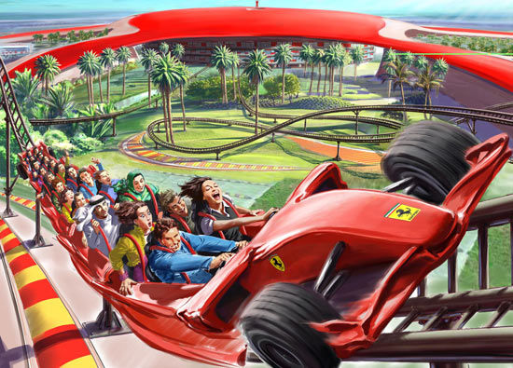
Complexity is in the eye of the beholder
Low entropy
High entropy
easier to compress
harder to compress
harder jigsaw puzzle
easier jigsaw puzzle

Slide 21
Capacity Result Explained
no coverage
interleaved (L-1)- repeats
(Ukkonen)
coverage constraint
L-1
L-1
L-1
L-1
attainable?

Slide 22
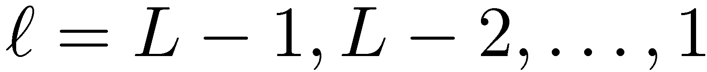
Greedy algorithm
Input: the set of N reads of length L
Set the initial set of contigs as the reads
Find two contigs with largest overlap and merge them into a new contig
Repeat step 2 until only one contig remains
Algorithm progresses in stages:
at stage
contig
overlap
merge reads at overlap
TexPoint fonts used in EMF.
Read the TexPoint manual before you delete this box.: AAAA

Slide 23
Greedy algorithm: the beginning
L-1
repeat
L-1
Repeats of length L-1?
Typically, when one repeat occurs, many interleaved repeats
occur as well.
So no interleaved (L-1)-repeats implies no (L-1)-repeats
with high probability.

Slide 24


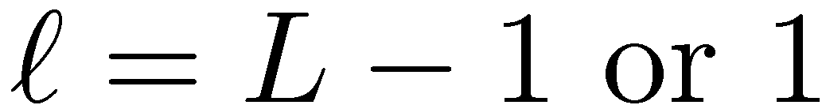
Greedy algorithm: stage
X
?
repeat
X
?
L-1
L-1
L-1
1
1
1
1
1
1
1
L-1
L-1
L-1
L-1
L-1
1
merge mistake → there must be a -repeat and
each copy is not bridged by a read.
Reduces to counting the expected number of such unbridged
- repeats for each
Worst case occurs when
Thus no (L-1)-repeats and coverage guarantee success.
bridging read already merged

Slide 25

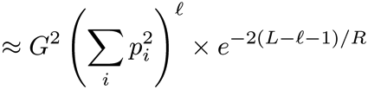
More detailed calculations
?
?
Starting positions of reads: Poisson with rate N/G = 1/R.
Worst case occurs either at

Slide 26
Summary: Two Regimes
coverage-limited
regime
repeat-limited
regime
Question:
Is this clean state of affairs tied to the i.i.d. DNA model?

Slide 27
I.I.D. DNA vs real DNA
Mammalian DNA has many long repeats.
How will the greedy algorithm perform for general DNA statistics?
Will there be a clean decomposition into two regimes?

Slide 28
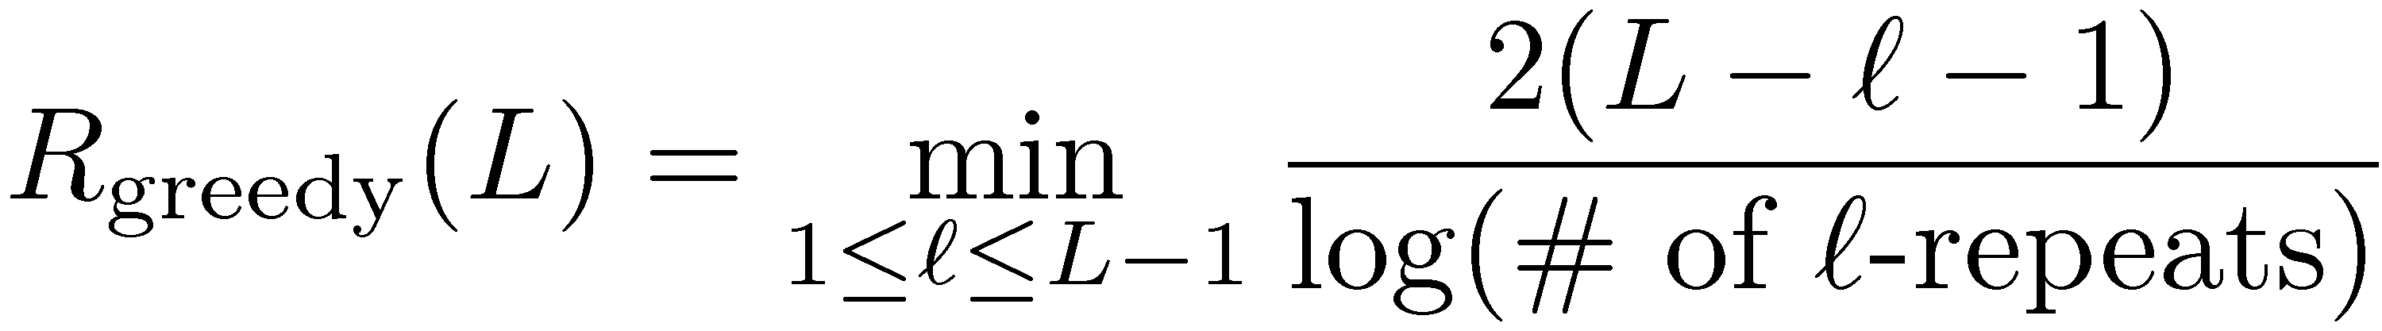
Greedy algorithm: general DNA statistics
?
?
Reconstruction if there are no unbridged repeats.
Performance depends on the DNA statistics through the number of - repeats:

Slide 29
I.I.D. DNA vs real DNA
upper bound
upper bound
data
i.i.d.
longest interleaved repeats
at 2325
longest repeat
at
GRCh37 Chr 22 (G = 35M)

Slide 30
Chromosome 19
longest interleaved repeats
at length 2248 (and 3412)
upper bound
longest repeat
at
GRCh37 Chr 19 (G = 55M)

Slide 31
Comparison of assembly algorithms
greedy
De Brujin
graph
sequential

Slide 32
Achievable rates on i.i.d. DNA
sequential algorithm
De Brujin graph
algorithm

Slide 33
Sequential Algorithm
small overlap
Intuition: when merging a read with small overlap, still many reads remaining.

Slide 34
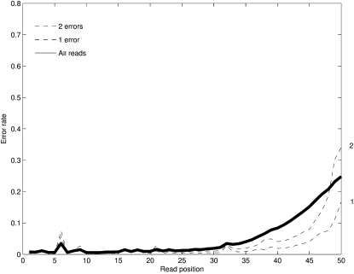
Read Noise
A
C
A
T
T
T
A
T
ACGTCCTATGCGTATGCGTAATGCCACATATTGCTATGCGTAATGCGT
Illumina noise profile

Slide 35
Modified greedy algorithm
X
Y
Y
We merge the two reads if Hamming distance is less
than a threshold.
Threshold optimized to tradeoff between false alarm and
mis-detection.

Slide 36
Impact on sequencing capacity
no-repeat constraint
coverage constraint

Slide 37
Ongoing work
Capacity-achieving assembly for general DNA statistics and noisy reads.
Reference-based assembly.
Partial reconstruction.
……...

Slide 38
Conclusion
An analogy between sequencing and communication is drawn
A notion of sequencing capacity is formulated
Framework for guiding design of algorithms and technologies

