Slide 1
The Science of Information:
From Communication to DNA Sequencing
David Tse
Dept. of EECS
U.C. Berkeley
UBC
September 14, 2012
Research supported by NSF Center for Science of Information.
Joint work with A. Motahari, G. Bresler, M. Bresler.
Acknowledgements: S. Batzolgou, L. Pachter, Y. Song
TexPoint fonts used in EMF: AAAAAAAAAAAAAAAA

Slide 2
Communication: the beginning
Prehistoric: smoke signals, drums.
1837: telegraph
1876: telephone
1897: radio
1927: television
Communication design tied to the specific source and specific physical medium.

Slide 3

Grand Unification
source
reconstructed source
Model all sources and channels statistically.
Shannon 48
Theorem:
A unified way of looking at all communication problems in terms of
information flow.

Slide 4
60 Years Later
All communication systems are designed based on the principles of information theory.
A benchmark for comparing different schemes and different channels.
Suggests totally new ways of communication.

Slide 5
Secrets of Success
Information, then computation.
  It took 60 years, but we got there.
Simple models, then complex.
The discrete memoryless channel
………… is like the Holy Roman Empire.
Infinity, and then back.
  Allows us to think in terms of typical behavior.

Slide 6
“Asymptotic limit is the first term in the Taylor series expansion
at infinity.
And theory is the first term in the Taylor series of practice.”
Tom Cover, 1990
TexPoint fonts used in EMF: AAAAAAAAAAAAAAAA

Slide 7
Looking Forward
Can the success of this way of thinking be broadened to other fields?

Slide 8
Information Theory of DNA Sequencing
TexPoint fonts used in EMF: AAAAAAAAAAAAAAAA

Slide 9
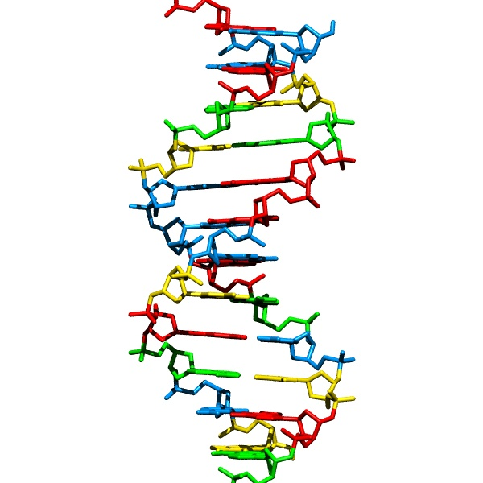
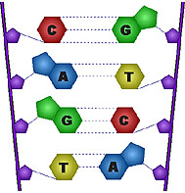
DNA sequencing
DNA: the blueprint of life
Problem: to obtain the sequence of nucleotides.
…ACGTGACTGAGGACCGTG
CGACTGAGACTGACTGGGT
CTAGCTAGACTACGTTTTA
TATATATATACGTCGTCGT
ACTGATGACTAGATTACAG
ACTGATTTAGATACCTGAC
TGATTTTAAAAAAATATT…
courtesy: Batzoglou

Slide 10
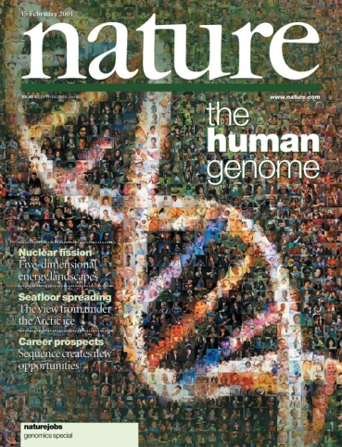
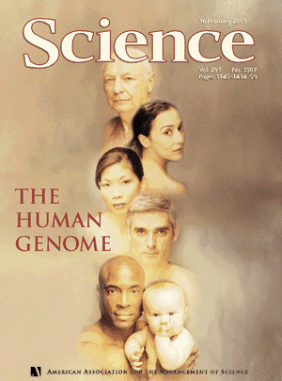
Impetus: Human Genome Project
1990: Start
2001: Draft
3 billion nucleotides
2003: Finished
3 billion $$$$
courtesy: Batzoglou

Slide 11
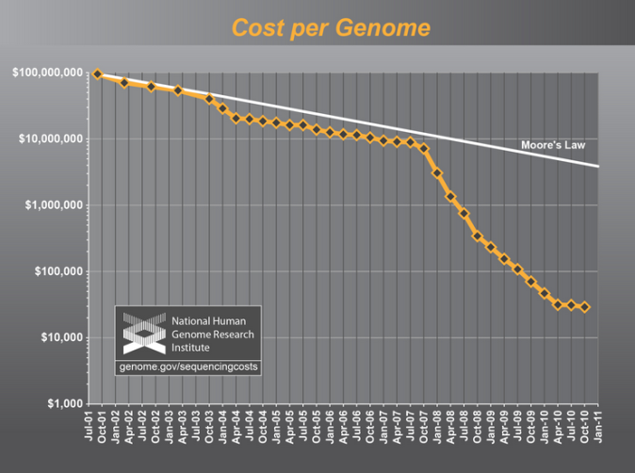
Sequencing gets cheaper and faster
Cost of one human genome
HGP: $ 3 billion
2004: $30,000,000
2008: $100,000
2010: $10,000
2011: $4,000
2012-13: $1,000
???: $300
courtesy: Batzoglou
Time to sequence one genome: years → days
Massive parallelization.

Slide 12
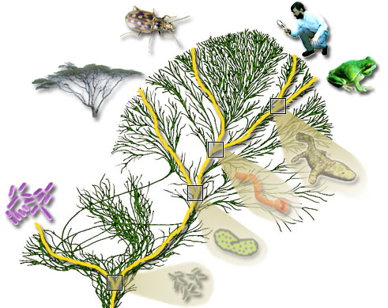
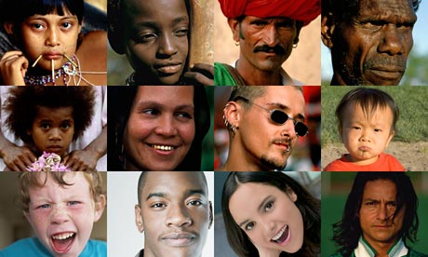
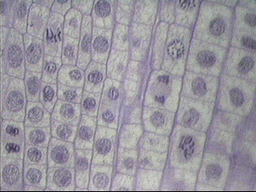
But many genomes to sequence
100 million species
(e.g. phylogeny)
7 billion individuals
(SNP, personal genomics)
10¹³ cells in a human
(e.g. somatic mutations
such as HIV, cancer)
courtesy: Batzoglou

Slide 13
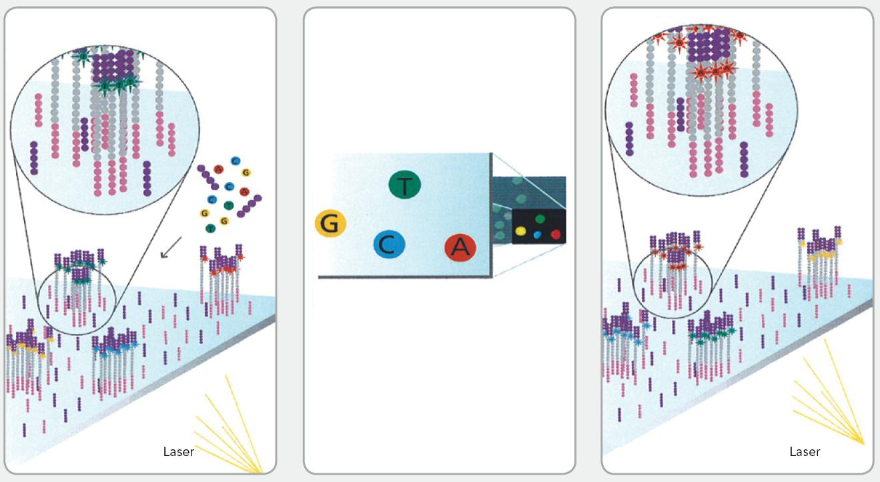
Whole Genome Shotgun Sequencing
Reads are assembled to reconstruct the original DNA sequence.

Slide 14
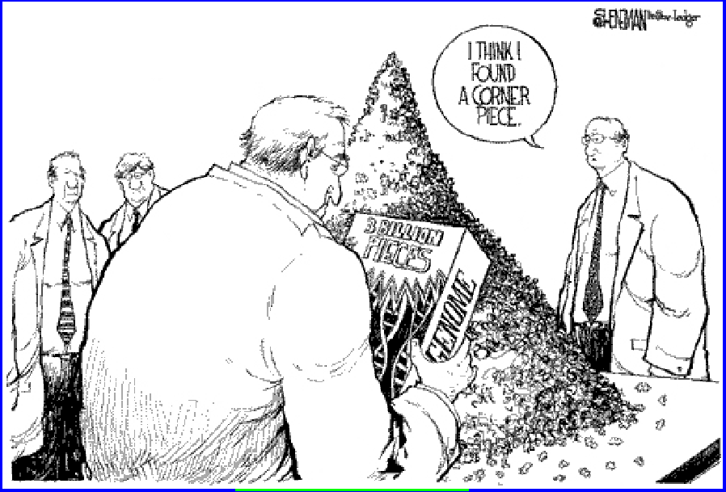
A Gigantic Jigsaw Puzzle

Slide 15
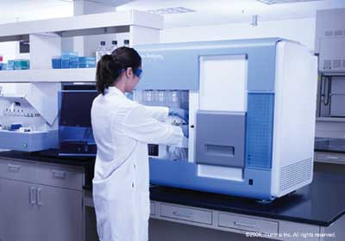
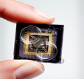
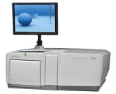
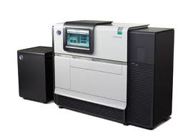
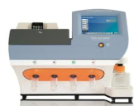
Many Sequencing Technologies
HGP era: single technology (Sanger)
Current: multiple “next generation” technologies (eg. Illumina, SoLiD, Pac Bio, Ion Torrent, etc.)
Each technology has different read length, noise statistics, etc

Slide 16
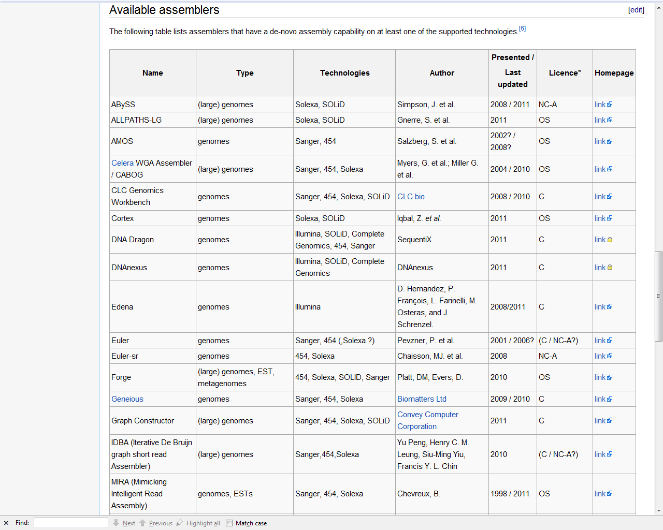
Many assembly algorithms
Source:
Wikipedia

Slide 17
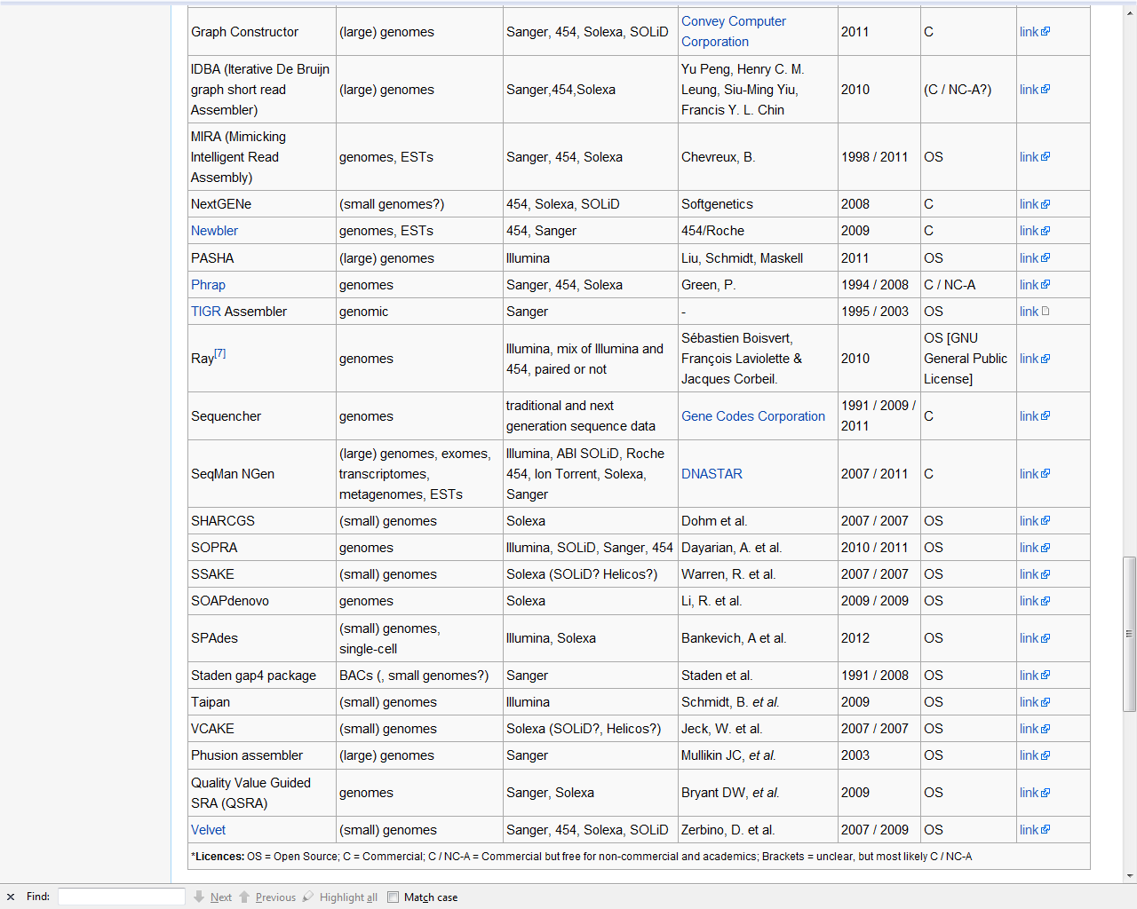
And many more…….
A grand total of 42!
Why is there no single optimal algorithm?

Slide 18
An information theoretic question
What is the minimum number of reads required for reliable reconstruction?
A benchmark for comparing different algorithms and different technologies.
An open question!

Slide 19
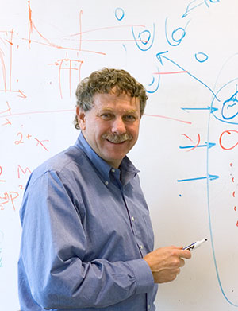
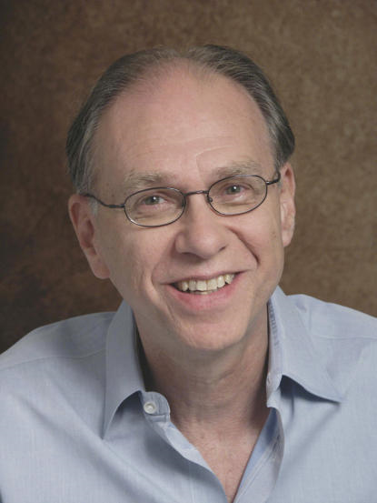
Coverage Analysis
Pioneered by Lander-Waterman
What is the minimum number of reads to ensure there is no gap between the reads with a desired prob.?
Only provides a lower bound on the minimum number of reads to reconstruct.
Clearly not tight.

Slide 20
Communication and Sequencing:
An Analogy
Communication:
source
sequence
Sequencing:
Question: what is the max. sequencing rate such that reliable reconstruction is asymptotically possible?

Slide 21
A Simple Model
DNA sequence: i.i.d. with marginal distribution
p=(p_{A}, p_{G}, p_{T}, p_{C}).
Starting positions of reads: uniform on the DNA sequence.
Read process: noiseless.
Will build on this to look at statistics from genomic data.

Slide 22
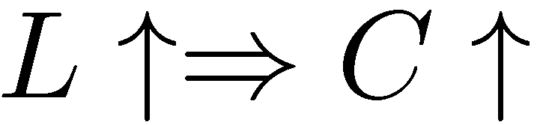
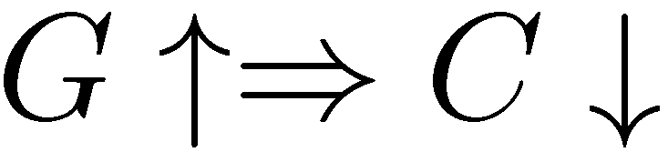
The read channel
Capacity depends on
  read length: L
  DNA length: G
Normalized read length:
Eg. L = 100, G = 3 x 10⁹ :
read
channel
AGCTTATAGGTCCGCATTACC
AGGTCC
L
G

Slide 23

Result: Sequencing Capacity
coverage constraint
Renyi entropy of order 2
The higher the entropy,
the easier the problem!

Slide 24

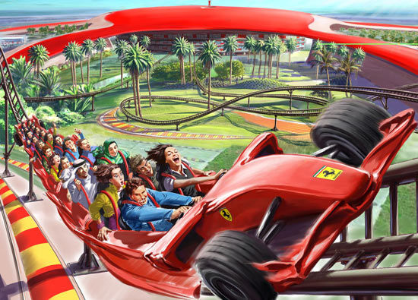
Complexity is in the eye of the beholder
Low entropy
High entropy
easier to compress
harder to compress
harder jigsaw puzzle
easier jigsaw puzzle

Slide 25



A necessary condition for reconstruction
interleaved repeats of length
None of the copies is straddled by a read (unbridged).
Reconstruction is impossible!
Special cases:
Under i.i.d. model, greedy is optimal for mixed reads.

Slide 26
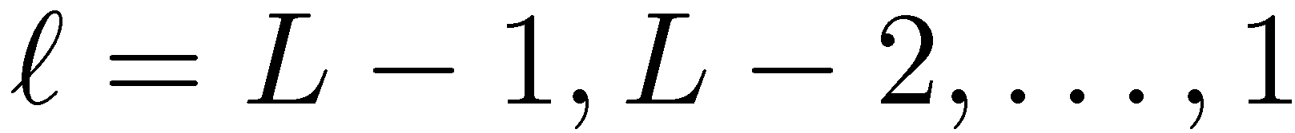
A sufficient condition: greedy algorithm
Input: the set of N reads of length L
Set the initial set of contigs as the reads
Find two contigs with largest overlap and merge them into a new contig
Repeat step 2 until only one contig remains
Algorithm progresses in stages:
at stage
contig
overlap
merge reads at overlap
TexPoint fonts used in EMF.
Read the TexPoint manual before you delete this box.: AAAA

Slide 27
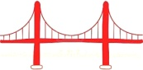
Greedy algorithm: stage
repeat
contigs
merge mistake => there must be a -repeat
and
each copy is not bridged by a read.
A sufficient condition for reconstruction:
There are no unbridged - repeats for any .
bridging read already merged

Slide 28
Summary
Necessary condition for reconstruction:
No unbridged interleaved -repeats for any .
Sufficient condition (via greedy algorithm)
No unbridged -repeats for any .
For the i.i.d. DNA model:
1) no unbridged interleaved repeats
=> w.h.p. no unbridged repeats.
2) Errors occur typically when either

Slide 29
Capacity Result Explained
interleaved (L-1)- repeats
coverage constraint
L-1
L-1
L-1
L-1

Slide 30
Comparison of assembly algorithms
greedy
De Brujin
graph
sequential

Slide 31
Achievable rates of algorithms
sequential algorithm
De Brujin graph
algorithm

Slide 32
Critical phenomenon
coverage-limited
regime
repeat-limited
regime
Question:
Is this clean state of affairs tied to the i.i.d. DNA model?

Slide 33
I.I.D. DNA vs real DNA
Example: human chromosome 22 (build GRCh37, G = 35M)
data
i.i.d. fit

Slide 34
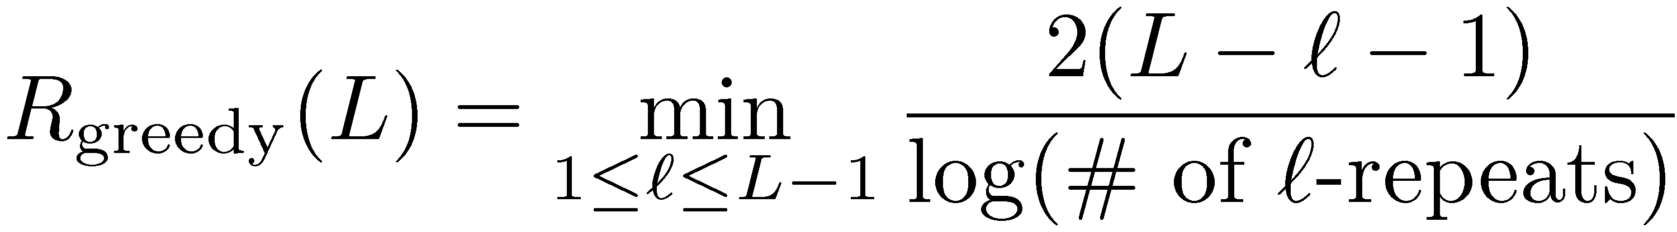
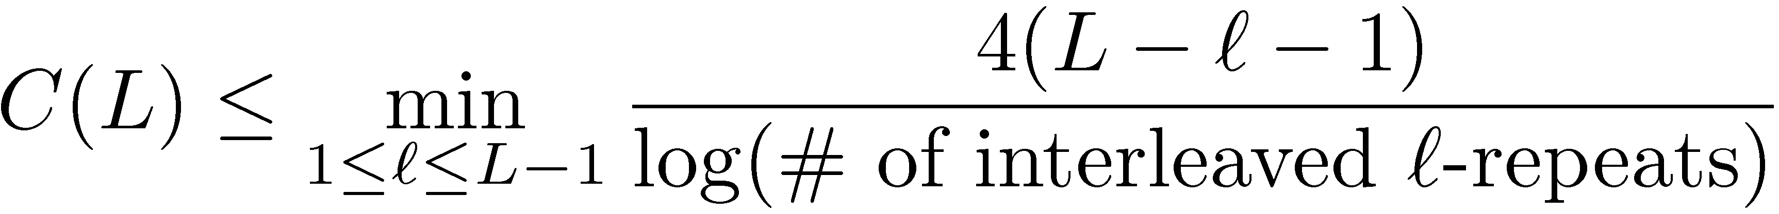
Greedy algorithm: general DNA statistics
?
?
Probability of failure at stage depends on:
  # of - repeats
  probability of not bridging a - repeat
Necessary condition translates similarly to an upper bound on capacity:

Slide 35
Sequencing capacity on Chr 22 statistics
upper bound
upper bound
critical phenomenon still occurs
longest interleaved repeats
at 2325
longest repeat
at
GRCh37 Chr 22 (G = 35M)

Slide 36
Chromosome 19
A hybrid greedy/De Brujin graph algorithm closes the gap and is near optimal on all 22 chromosomes.
longest interleaved repeats
at length 2248
upper bound
longest repeat
at
GRCh37 Chr 19 (G = 55M)

Slide 37
Ongoing work
Noisy reads.
Reference-based assembly.
Partial reconstruction.
……...

Slide 38
Conclusion
Information theory has made a huge impact on communication.
Its success stems from focusing on something fundamental: information.
This philosophy may be useful for other important engineering problems.
DNA sequencing is a good example.

